Slide 1
Team 1:
„Liquidity”
Final meeting ICV Work Group 2020
06.11.2020
Team members:
Jörn Ney, Luiza Arcab, Mariusz Rzeźnikiewicz, Anita Lazovic

Slide 2
?

Slide 3
Liquidity – Our Approach
How to consider RISK (of pandemic) in the planning model?

Slide 4
What can be an impact on our liquidity?

Slide 5
How far can we influence Working Capital to stay safe with cash position?

Slide 6
Monte-Carlo-Simulation

Slide 7
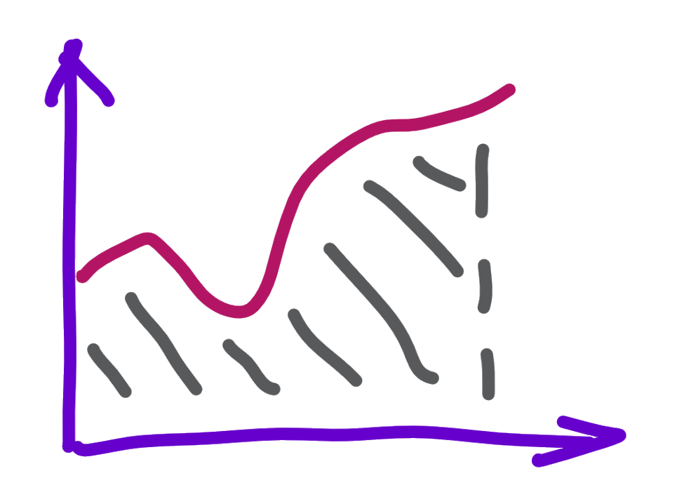
Monte-Carlo-Simulation
A Monte Carlo simulation is a model used to predict the probability of different outcomes when the intervention of random variables is present.
Monte Carlo simulations help to explain the impact of risk and uncertainty in prediction and forecasting models.
Only with MCS is possible to:
perform thousands of sensitivity analysis and scenario analysis
simulate and aggregate the different risk
get the probability distributions, which are necessary for making business decisions

Slide 8
Liquidity Model as supporting tool
Creation
From very beginning
Own team work
Knowledge investigtion

Slide 9
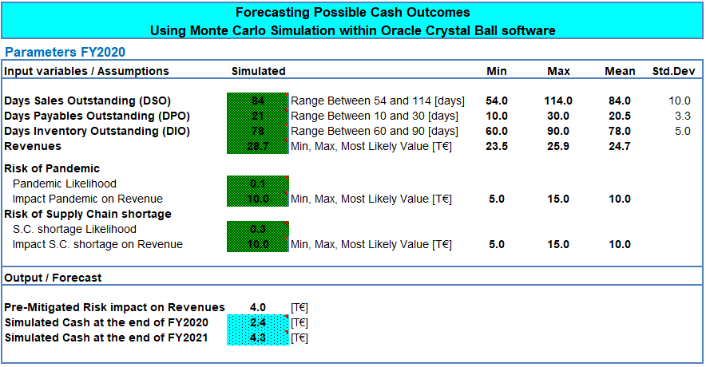
Liquidity Model
Interpreat the outcomes
Run the simulation with Monte Carlo
Add the risk (likelihood/impact) to the model
Define assumptions (range,distribution parameters)
Define the key risk input variables

Slide 10
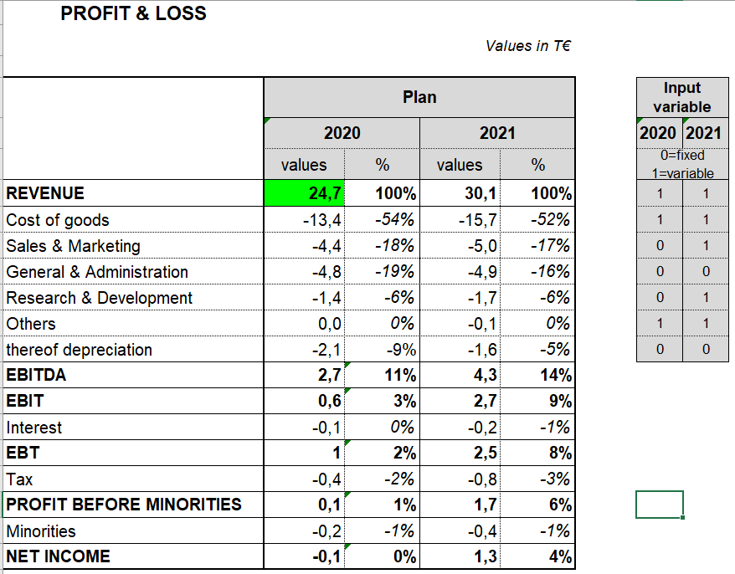
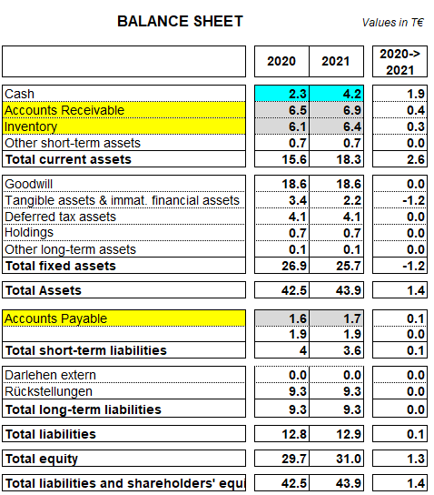
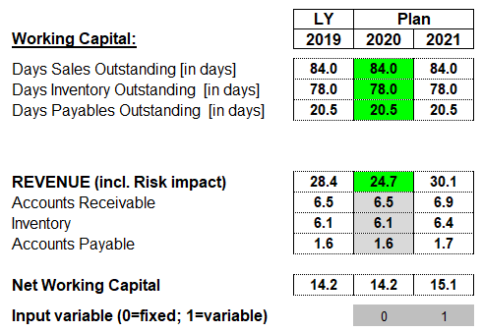
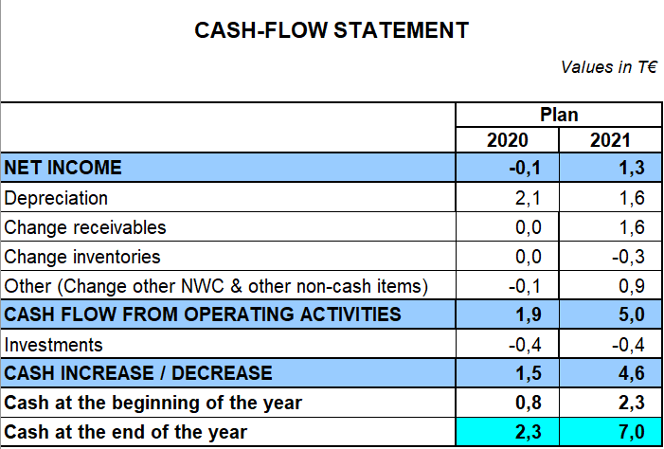
Define the key risk input

Slide 11
Assumptions - range & distribution parameters
Add the risk (likelihood/impact) to the model

Slide 12
Run the simulation with Monte Carlo
Interpreat the outcomes
There is a 40% chance of a cash forecast value being equal to or less than 0 € in FY2021.

Slide 13
Monte-Carlo-Simulation

Slide 14
Liquidity Management
How to optimize working capital management in your company to stay with positive cashflow ?

Slide 15
Liquidity Management
Customer Payment Terms Management Policy
DSO = 84 days +/- 30 days

Slide 16
Customer Policy - Critical Questions to Answer
What is the probability of running out of cash if customers on average pay 20 or 30 days later ?
How many additional days of collecting receivables could I accept to be 75% sure of having positive cash flow at the end of year ?
What is the expected value of days of collecting receivables to lower probability of running out of cash to 3%? Then, how many days I should shorten collecting receivables on average ?

Slide 17
How to find answers in a few minutes?

Slide 18
What is the probability of running out of cash if customers on average pay 30 days later ?

Slide 19
How many additional days of collecting receivables could I accept to be 75% sure of having positive cash value at the end of year ?

Slide 20
What is the expected value of days of collecting receivables to lower probability of running out of cash to 3%? Then, how many days I should shorten collecting receivables on average ?

Slide 21
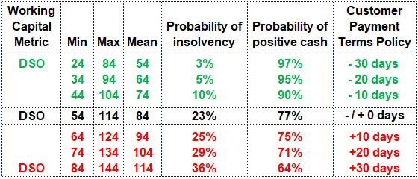
What is the best customer payment terms management policy – based on Monte-Carlo-Sim?

Slide 22
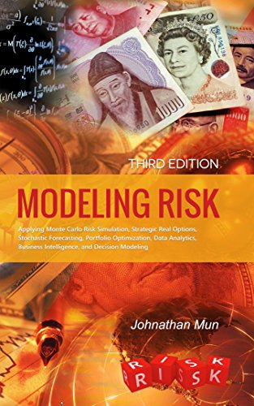
Monte-Carlo-Simulation
https://youtu.be/BZZLRpwrDLI

