Slide 1

ICV international work group
23.10.2015
strategy-development
is a need for every company

Slide 2
Combine a strategy with the Balanced Scorecard
Agenda
01 08:00 overview what is strategy, why do you need this
02 08:30 practica exercise in 2 groups: what could be our mission / vision – with presentation
03 09:30 internal analysis and strategy choice
04 09:50 practica exercise in 2 groups:
our strategic goals (topics) for the next two years – with presentation
05 10:50 our important stakeholders
06 11:10 practical exercise in 2 groups: strategic actions
07 11:40 conclusion of the strategic process
2
Notes:
2

Slide 3
The future has many names.
For the weak, it is the unreachable.
For the fearsome, it is the unknown.
For the brave, it is the chance.
___________________
Victor Hugo

Slide 4
We want, we have to prepare for our future,
even though it is not a 100% controllable !
„Whatever will be, will be“;
nonetheless, we can, we have to do something today for the future.
Therefore, we should
at least meet the requirements of the future
or better: set standards
or even: try to influence the changes in society

Slide 5
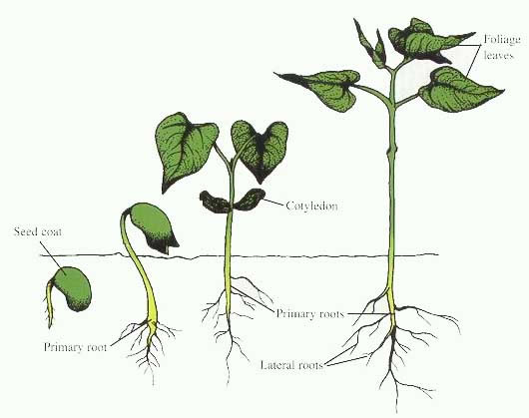

Why a strategy is a need for every company?
We know where to go
We achieve joint objectives
We translate strategies into action
By communication we achieve thinking, responsibility, objective-orientated action of our employees and partners
We assure sustainability of our company

Slide 6

Requirements to start the process of strategy implementation
Willingness for change – be open for new ideas
Reduce Blame-Culture – learning to learn from mistakes:
“no mistake is the biggest mistake”
Willingness of management to work out
and discuss strategic objectives
A strategy !

Slide 7
Failure is a step to success.
___________________
Pawel Musial

Slide 8
Needs of strategy
FUTURE DIRECTION
+
OBJECTIVE PATH
+
COURSE OF ACTION
Strategic management as a process
Aim: guide managers
Notes:
(how to implement strategies to achieve organisational goals)

Slide 9
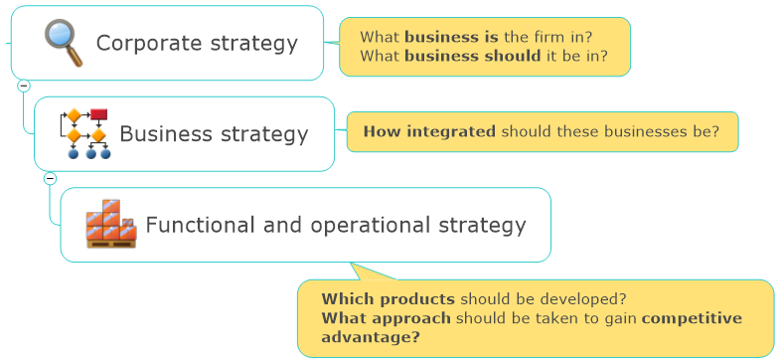
Levels of strategy

Slide 10

What is strategic, what is operational ?
short-term ?
to do ?
long-term ?
Expenditures
to do nothing ?
strategic
operational
develop
Potentials
Possibilities
+
competencies
exploit
Marketing
Develop capacities
Quality potential
HR competences
Investor Relations
Partnership
Orders / Sales
Use capacities
Quality assurance
Employee engagement
Safeguarding liquidity
Partner engagement
Growth of potentials
Growth of money
Notes:
Geändert Folie 22: Qualitätspotenzial und Qualitätssicherung

Slide 11
Aspects of the development of potential
financial resources
orientation by objectives
motivation for implementation
time resources
x
x
x
economic force

Slide 12
Strategic questions
Business-idea
1. Do we know the business-idea of our company ?
Future orientation
Business-model
2. Is it possible to earn enough money with this business-idea ?
Orientation
3. What kind of corporate policy orientation follows our business-idea ?
Concretion
4. Do we have concrete ideas to reach the orientation ?
Business processes
Balanced Scorecard
5. With which strategic projects do we want to start now ?
Medium term planning
6. How do we connect these strategic projects into our business plans ?
Reporting
Budget / Liquidity
7. How can we finance the planned strategic projects ?

Slide 13
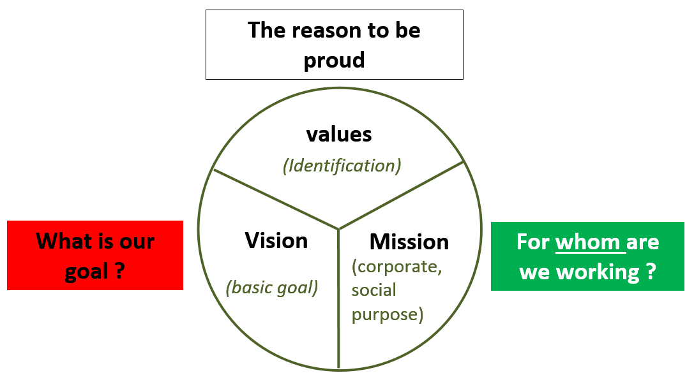
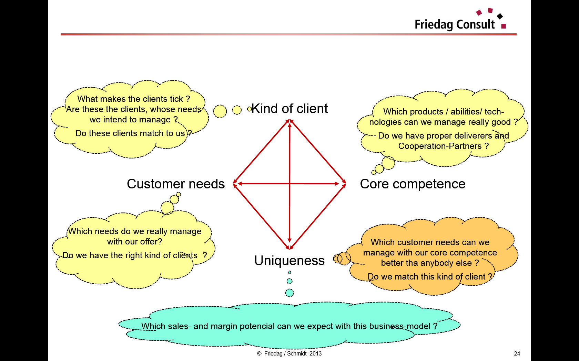
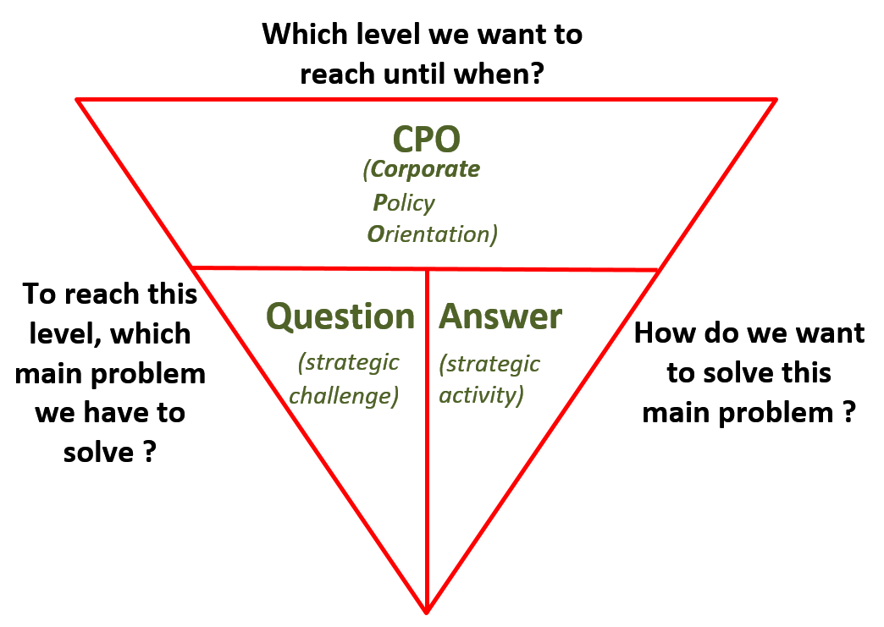
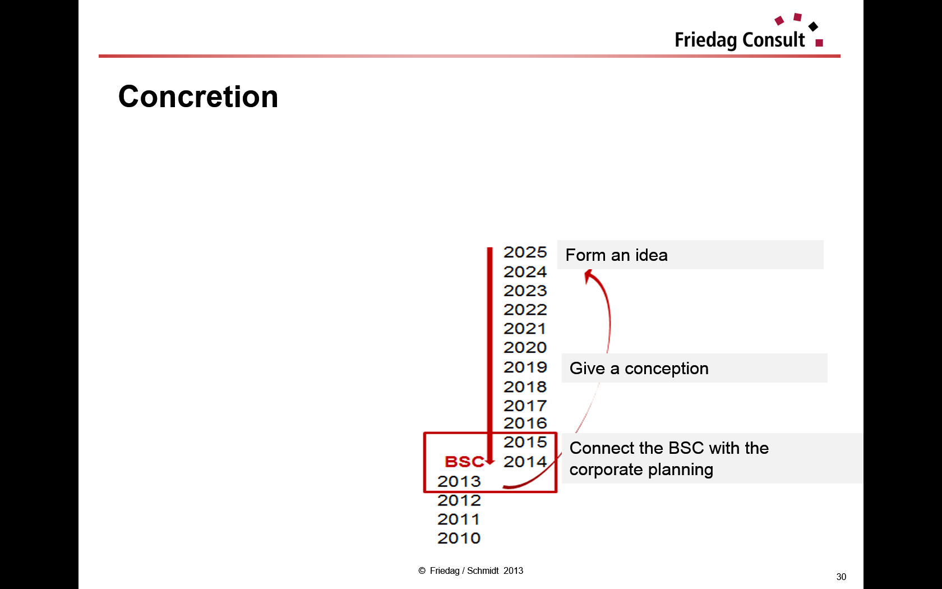
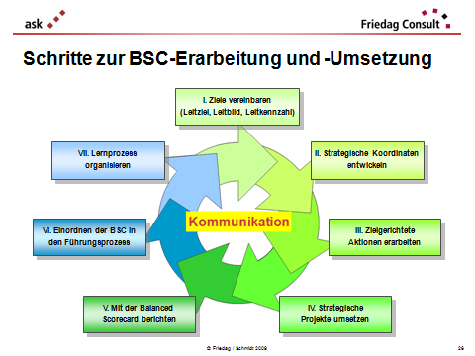
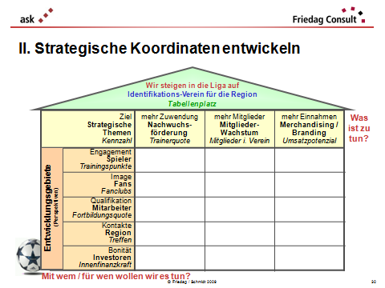
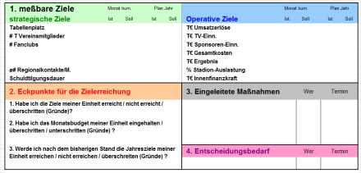
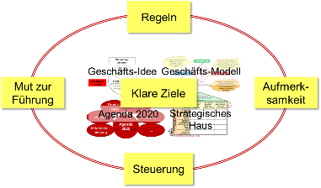
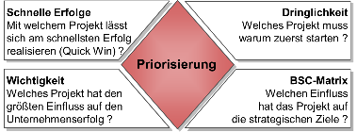
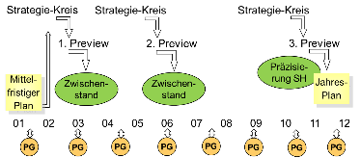
Strategic dimensions and how we proceed
“timeless“
Concept
Business-idea
Business-model
3 – 10 years
Strategy-develop-ment
Corporate policy orientation
Concretion
Reporting-Scorecard
Strategic House
1 – 3 years
Strategy-
imple-mentation
Strategic
Projects
Balanced Scorecard
balance
of goals
Intermediate-term planning
current year
Use of strategic-
potentials
project-management
consequence-management
Previews

Slide 14
Strategic steps
“timeless“
Concept
Business-idea
Business-model
3 – 10 years
Strategy-develop-ment
Corporate policy orientation
Concretion
Reporting-Scorecard
Strategic House
1 – 3 years
Strategy-
imple-mentation
Strategic
Projects
Balanced Scorecard
balance
of goals
Intermediate-term planning
current year
Use of strategic-
potentials
project-management
consequence-management
Previews

Slide 15
Steps to create a strategy
Business-idea
Business-model
Corporate policy orientation (CPO)
Concretion
→ Balanced Scorecard

Slide 16
Business-Idea
Try to describe your company in 2020 in five words
as short as possible
as simple as possible

Slide 17
Exercise: business-idea
What could be the business idea of our company:
Define in 5 words your company in 2020
Plenum-work
17
Notes:
17

Slide 18
Business-Idea
Values: Beliefs or ideals
what is desirable or not.
common business values are fairness, innovation and community involvement
The reason to be proud
Values have major influence
on behavior and attitude
and are a guideline in
all situations.
Values
(Identification)
Vision
Mission
What is our goal ?
For whom are we working ?
(basic goal)
(corporate,
social
purpose)
What could for us
be always a challenge ?
No target, but a motivation for us,
to form always new goals !
    What is our unique contribution for other
    people, for our society ?
    Who is missing what, if we would not be there ?

Slide 19

Example: Values, Vision and Mission
Company producing rear-view mirrors for cars
The values of this company are:
innovation
trust in our family
respect
The business idea, the very long-time interior goal,
the “vision” of this company:
the leading car-manufacturers for our clients
Our corporate purpose, our “mission”:
we produce high-tech safety

Slide 20
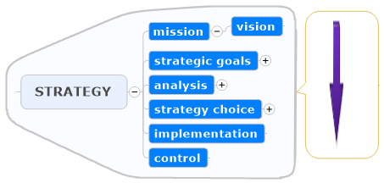
Strategy formulation

Slide 21
Strategy formulation
Mission formulation is very difficult for a company that is not new.
Tradition, years of existence, makes this task more difficult as the main idea of the business might be changed during years in different business units.
EFFECTIVE VALUES:
…
EFFECTIVE VISION:
…
EFFECTIVE MISSION:
…

Slide 22
Combine a strategy with the Balanced Scorecard
Agenda
01 08:00 overview what is strategy, why do you need this
02 08:30 practica exercise in 2 groups: what could be our mission / vision – with presentation
03 09:30 internal analysis and strategy choice
04 09:50 practica exercise in 2 groups:
our strategic goals (topics) for the next two years – with presentation
05 10:50 our important stakeholders
06 11:10 practical exercise in 2 groups: strategic actions
07 11:40 conclusion of the strategic process
22
Notes:
22

Slide 23
Exercise: business-idea
What could be the business idea of our company:
The 3 most important (group) values
Vision
Mission
You have 30 minutes time
23
Notes:
23

Slide 24
1. business-idea
5 words for company in 2020
most important values
Vision
Mission
2. business model
3. CPO
4. concretion

Slide 25
Strategic steps
“timeless“
Concept
Business-idea
Business-model
3 – 10 years
Strategy-develop-ment
Corporate policy orientation
Concretion
Reporting-Scorecard
Strategic House
1 – 3 years
Strategy-
imple-mentation
Strategic
Projects
Balanced Scorecard
balance
of goals
Intermediate-term planning
current year
Use of strategic-
potentials
project-management
consequence-management
Previews

Slide 26
Steps to create a strategy
Business-idea
Business-model
Corporate policy orientation (CPO)
Concretion
→ Balanced Scorecard

Slide 27
The business-model
The business-model is a plausibility check for the business-idea
What makes the clients tick ?
Are these the clients, whose needs we intend to manage ?
Do these clients match to us ?
Kind of client
Which products / abilities/ tech-nologies can we manage really good ?
Do we have proper deliverers and Cooperation-Partners ?
Customer needs
Core competence
Which needs do we really manage with our offer?
Do we have the right kind of clients ?
Which customer needs can we manage with our core competence better tha anybody else ?
Do we match this kind of client ?
Uniqueness
Which sales- and margin potencial can we expect with this business-model ?

Slide 28
Business-model
Who is our customer ?
Kind of clients
How can we find a cost-covering solution for that? Core competence
What are the needs of our customer?
Customer need
How can we be better than the competitors?
Uniqueness
You may have different business models in a company – less is easier
© Friedag / Lewandowska 2008
28
Notes:
28

Slide 29
Example: business-model
Company producing rear-view mirrors for cars
Kind of clients:
Developer of the leading car-manufacturers
Core competence:
we can develop new technologies and we can produce these innovative items with best quality
Customer need:
to be with high-tech rear-view mirrors more innovative and safe than other car manufacturers
Uniqueness:
secure processes in innovation - and then production

Slide 30
Exercise: business-model
What should be the business-model of our example company:
kind of clients we want to have
core competence
customers need
uniqueness
You have 30 minutes time
No time to do this – but your actual business-model is quite difficult !
30
Notes:
30

Slide 31
Steps to create a strategy
Business-idea
Business-model
Corporate policy orientation (CPO)
Concretion
→ Balanced Scorecard

Slide 32
Corporate Policy Orientation (CPO)
Which level we want to reach until when?
CPO
(Corporate
Policy
Orientation)
Question
Answer
To reach this level, which main problem we have to solve ?
How do we want to solve this main problem ?
(strategic
challenge)
(strategic
activity)

Slide 33
Example: Corporate Policy Orientation
Company producing rear-view mirrors for cars
the Corporate Policy Orientation, defined by the owners and/or
the board of directors:
target-year: 2025 actual
  Patent applications: 10 p.a. 3 p.a.
  Sales: 2.500 Mio € 750 Mio €
  Profit-margin: 7% 3,5%

Slide 34
Exercise: Corporate Policy Orientation (CPO)
What should be goals for 2025 (?) of our example company:
Number of A-clients …
Turn-over …
Employees …
Profit-rate …
You have 30 minutes time
No time to do this – but did you define your goals for 2025 ?
34
Notes:
34

Slide 35
Steps to create a strategy
Business-idea
Business-model
Corporate policy orientation (CPO)
Concretion
→ Balanced Scorecard

Slide 36
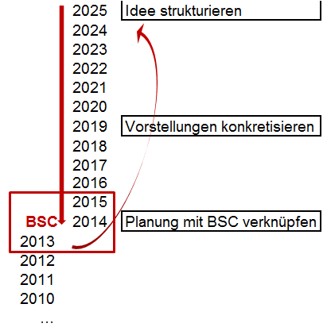
Concretion
Of course, for doing the first step You should know what will happen in the future – but not in detail
Idea: What goals could be
achieved in the remote future ?
Conception: What has to be
prepared for the near future ?
Connection: What has to be
defined for the next 1 - 2 years ?
Form an idea
Give a conception
Connect the BSC with the
corporate planning

Slide 37
Example: Concretion
The Concretion until 2015 could be:
Idea: What goals could
be achieved in the years
8 – 15 ?
Conception: What has
to be prepared for the
years 3 – 7 ?
Connection: What has
to be defined for the
next 2 years ?
Idea until 2025:
- most new cars are equipped with
our rear-view mirrors
- all innovative companies are
developing together with us
Conception until 2020:
- having development-projects
together with clients
- built up six sigma-oriented
production
Connection until 2016:
- built up capacities for development
- internationalisation of the company

Slide 38
Exercise 5: Concretion
Have ideas for the concretion of the goals for 2025 (?):
idea (8-15 years)
a)
b)
c)
conception (3-7 years)
a)
b)
c)
connection (1-2 years)
a)
b)
c)
You have 30 minutes time
38
Notes:
38

Slide 39
Combine a strategy with the Balanced Scorecard
Agenda
01 08:00 overview what is strategy, why do you need this
02 08:30 practica exercise in 2 groups: what could be our mission / vision – with presentation
03 09:30 internal analysis and strategy choice
04 09:50 practica exercise in 2 groups:
our strategic goals (topics) for the next two years – with presentation
05 10:50 our important stakeholders
06 11:10 practical exercise in 2 groups: strategic actions
07 11:40 conclusion of the strategic process
39
Notes:
39

Slide 40
Internal analysis
internal analysis and strategy choice
Edyta: discussion about their actual situation: no new markets, no new products, no focus : cheap or personalized (is netting a part of the process or only for selling? Exercise by Edyta)
Is Customer willing to pay for everything from companies value chain???
What values does we propose?
Do you really feel your Customer needs?

Slide 41



Strategy choice
COST LEADER in Europe?
internal analysis and strategy choice
Edyta: discussion about their actual situation: no new markets, no new products, no focus : cheap or personalized (is netting a part of the process or only for selling? Exercise by Edyta)
FOCUS on Innovation?
DIVERSIFICATION in Poland ?
New markets ?
strategy evaluation

Slide 42
More successful with a strategy ?
We have joint and clearly defined strategic and operative objectives
By communication we achieve thinking, responsibility, objective-orientated action of all of our employees and partners
Better transparency creates confidence at internal and external partners
Strategy is the first task of leaders !

Slide 43

IT IS NOT IMPORTANT
TO DIVIDE A CAKE INTO PIECES…

Slide 44

IMPORTANT IS TO MAKE THE BIGGEST CAKE!

Slide 45
Strategic steps
“timeless“
Concept
Business-idea
Business-model
3 – 10 years
Strategy-develop-ment
Corporate policy orientation
Concretion
Reporting-Scorecard
Strategic House
1 – 3 years
Strategy-
imple-mentation
Strategic
Projects
Balanced Scorecard
balance
of goals
Intermediate-term planning
current year
Use of strategic-
potentials
project-management
consequence-management
Previews

Slide 46
Implementation steps for a Balanced Scorecard
I. Identification of objectives
(key image, key objective,
key indicator)
VII. Organize learning process
II. Develop strategic
action frame
Communication
VI. Arrange the BSC into the
process of leading
III. Complete action frame
with actions (collect ideas)
V. Reporting with the
Balanced Scorecard
IV. Bundle actions into
strategic projects

Slide 47
Implementation steps for a Balanced Scorecard
I. Identification of objectives
(key image, key objective,
key indicator)
VII. Organize
learning process
II. Develop strategic
action frame
Communication
VI. Arrange the BSC into the
process of leading
III. Complete action frame
with actions (collect ideas)
V. Reporting with the
Balanced Scorecard
IV. Bundle actions into
strategic projects

Slide 48

Goals we want to realise in the next future
What we focus on the implementation of the strategy ?
  What will be our strategic period? (1-3 years)
  Key objective
  What do we want to achieve in this period ?
  (a “milestone“ of the vision)
  Key image
  Strategic message: How do we want to be seen after this period ?
  Key indicator
  How can we recognise that we are successful?

Slide 49
Key objective (short time vision)
What do we want to achieve in the next 1 – 2 years ?
The key objective is destined for our company‘s employees.
We start to be a technological market leader

Slide 50
Key image (short time Mission statement )
Why shall people be our customers ?
The key image aims at the memory of our potential customers / partner.
With the key image we raise expectations that we have to meet in the near future.
We are a worldwide innovative supplier of rear-view mirrors.

Slide 51
Key indicator
One key indicator for the company
What shall be the most important criteria that subordinates all strategic decisions?
How do we want to measure that ?
With the key indicator,
we concretise our joint orientation
Key indicator: number of jointly (with customers) developed innovations
The KPI-Team brings surely some ideas !

Slide 52
Agreement on objectives
key objective
key image
We start to be the
technological market leader
worldwide
innovative supplier of
rear-view mirrors
number of jointly (with customers) developed innovations
key indicator

Slide 53
Exercise: goals for the next future
What could be for our company the
strategic period
key objective,
key image and the
key indicator
  You have 30 minutes time
53
Notes:
53

Slide 54
Combine a strategy with the Balanced Scorecard
Agenda
01 08:00 overview what is strategy, why do you need this
02 08:30 practica exercise in 2 groups: what could be our mission / vision – with presentation
03 09:30 internal analysis and strategy choice
04 09:50 practica exercise in 2 groups:
our strategic goals (topics) for the next two years –
with presentation
05 10:50 our important stakeholders
06 11:10 practical exercise in 2 groups: strategic actions
07 11:40 conclusion of the strategic process
54
Notes:
54

Slide 55
Implementation Steps for a Balanced Scorecard
I. Identification of objectives
(key image, key objective,
key indicator)
VII. Organize learning process
II. Develop strategic
action frame
Communication
VI. Arrange the BSC into the
process of leading
III. Complete action frame
with actions (collect ideas)
V. Reporting with the
Balanced Scorecard
IV. Bundle actions into
strategic projects

Slide 56
II. Developing the strategic action frame
key objective:
We start to be the technological market leader
key image:
Worldwide innovative supplier of rear-view mirror
key indicator: Number of jointly (with customers) developed innovations
Which potentials do we have to jointly develop so we are able to face the future better than the competitors can do it?
Which tasks do we have to fulfil, in order to achieve our vision?
➔ strategic topics
Which potentials do we have to develop in order to achieve our vision?
➔ perspectives
56

Slide 57
Strategic topics
we start to be the
technological market leader
worldwide innovative supplier
number of jointly developed innovations
objective
strategic topic
Indicator
higher revenue
extension of sales dept.
sale potential
image
jointly developed innovations
# of projects
development
Recruitement of internat. oriented engineers
# of employments
customer retention Customers new contracts
dedication employees CIP-Groups
reliability processes error ratio (ppm)
reliability partners audits
cost consciousness fin. & controlling Cash Flow
what shall we do now?
Perspectives
Perspectives

Slide 58

Strategic topics
we build up a „net-R&D“-department
Wo Innovation in the meat market come from Poland
number of talks with meat-producers
objective
strategic topic
Indicator
customer retention Customers new contracts
dedication employees CIP-Groups
reliability processes error ratio (ppm)
reliability partners audits
cost consciousness fin. & controlling Cash Flow
what shall we do now?
Perspectives
Perspectives

Slide 59
Exercise 7: Strategic topics
What are the two main tasks (services, products, changes)
that we have to devote ourselves to in order to achieve the vision
in the near future ?
For each topic, define an objective and an indicator with which
we can measure the achievement
Less is more !
Recommendation: less than five, best two or three strategic topics
  You have 30 minutes time
59
Notes:
59

Slide 60
Exercise-results
6. Our example company
7. Strategic Topics
8. Perspectives of the stakeholders
Perspective 1 | Goal:
 | Name:
 | Indicator:
Perspective 2 | Goal:
 | Name:
 | Indicator:
Perspective 3 | Goal:
 | Name:
 | Indicator:
9. Target-Action-Indicator (TAI)
10. Strategic Projects

Slide 61
Combine a strategy with the Balanced Scorecard
Agenda
01 08:00 overview what is strategy, why do you need this
02 08:30 practica exercise in 2 groups: what could be our mission / vision – with presentation
03 09:30 internal analysis and strategy choice
04 09:50 practica exercise in 2 groups:
our strategic goals (topics) for the next two years – with presentation
05 10:50 our important stakeholders
06 11:10 practical exercise in 2 groups: strategic actions
07 11:40 conclusion of the strategic process
61
Notes:
61

Slide 62
Perspectives for the stakeholder
we start to be the
technological market leader
worldwide innovative supplier
number of jointly developed innovations
objective
strategic topic
Indicator
higher revenue
extension of sales dept.
sale potential
image
jointly dev. innov.
# of projects
extension of local presence
entry into chinese market
trade volume
CIP = continuous improvement process
Customer retention
Customers
New contracts
dedication
employees
CIP-Groups
With whom and for whom do we intend to do it ?
Perspectives
Perspectives
reliability
Partners
Audits
Cost consciousness
fin. & controlling
Cash Flow

Slide 63
Example for a strategic frame
we build up a „net-R&D“-department
Wo Innovation in the meat market come from Poland
number of talks with meat-producers
objective
Strategic topic
Indicator
Customer Knowledge
Meat-Producer
Visits in Bytom
dedication
employees
CIP-Groups
Perspectives
max. 6 perspectives and 4 topics – less is better !
Perspectives
Zusammenarbeit
University
# of diploma works
Cost consciousness
family
Cash Flow

Slide 64
Relevant stakeholders
priorities
goals
reports
risk appetite
relations

Slide 65
Exercise: business-idea
Who are our most important 3 stakeholders
Plenum-work
65
Notes:
65

Slide 66
Combine a strategy with the Balanced Scorecard
Agenda
01 08:00 overview what is strategy, why do you need this
02 08:30 practica exercise in 2 groups: what could be our mission / vision – with presentation
03 09:30 internal analysis and strategy choice
04 09:50 practica exercise in 2 groups:
our strategic goals (topics) for the next two years – with presentation
05 10:50 our important stakeholders
06 11:10 practical exercise in 2 groups: strategic actions
07 11:40 conclusion of the strategic process
66
Notes:
66

Slide 67
Implementation Steps for a Balanced Scorecard
I. Identification of objectives
(key image, key objective,
key indicator)
VII. Organize learning process
II. Develop strategic
action frame
Communication
VI. Arrange the BSC into the
process of leading
III. Complete action frame
with actions (collect ideas)
V. Reporting with the
Balanced Scorecard
IV. Bundle actions into
strategic projects

Slide 68
Kaplan/Norton
Translate strategy into action!
It is only through the concrete, daily actions of all the employees in a company that potentials can be developed .
68
Notes:
68

Slide 69
III. Objective-oriented actions - the TAI-principle
Strategic topics
Development areas (perspectives)
Target
Action
Indicator
Check if every action matches
the strategic topics and
the development areas (perspectives)!
69
Notes:
69

Slide 70
Define target-orientated actions
we start to be a
technological market leader
worldwide innovative supplier
number of jointly developed innovations
objective
Strategic topic
Indicator
higher revenue
extension of sales dept.
sale potential
image
jointly developed innovations
# of projects
development
Recruitement of internat. oriented engineers
# of employments
Customer retention
Customers
New contracts
Target: create enthusiasm at the customers
Action: customer visits approx. 8 weeks after first delivery: „Any problems ?"
Indicator: number of visited customers
dedication
employees
CIP-Groups
Perspectives
Perspectives
reliability
Partners
Audits
Cost consciousness
fin. & controlling
Cash Flow

Slide 71
Define target-orientated actions
we build up a „net-R&D“-department
Innovation in the meat market come from Poland
number of talks with meat-producers
objective
Strategic topic
Indicator
i
j
# of
i
j
# of
i
j
# of
Customer Knowledge
Producer
Visits
Target: awake knowledge about XYZ
Action: customer visits approx. 8 weeks after first fair-meeting
Indicator: number of visited customers
dedication
employees
CIP-Groups
Perspectives
Perspectives
Working together with
University
# of diploma works
Cost consciousness
family
Cash Flow

Slide 72
Create target-orientated actions
we start to be a
technological market leader
worldwide innovative supplier
number of jointly developed innovations
objective
Strategic topic
Indicator
higher revenue
extension of sales dept.
sale potential
image
jointly developed innovations
# of projects
development
Recruitement of internat. oriented engineers
# of employments
Customer retention
Customers
New contracts
Target
Action
Indicator
Target
Action
Indicator
Target
Action
Indicator
Target
Action
Indicator
Target
Action
Indicator
dedication
employees
CIP-Groups
Target
Action
Indicator
Target
Action
Indicator
Target
Action
Indicator
Target
Action
Indicator
Target
Action
Indicator
Target
Action
Indicator
Target
Action
Indicator
Target
Action
Indicator
Perspectives
Perspectives
Target
Action
Indicator
Target
Action
Indicator
Target
Action
Indicator
Target
Action
Indicator
Target
Action
Indicator
Reliability
Partners
Audits
Target
Action
Indicator
Target
Action
Indicator
Target
Action
Indicator
Target
Action
Indicator
Target
Action
Indicator
Cost consciousness
fin. & controlling
Cash Flow
Target
Action
Indicator
Target
Action
Indicator
Target
Action
Indicator
Target
Action
Indicator
Target
Action
Indicator
Target
Action
Indicator

Slide 73
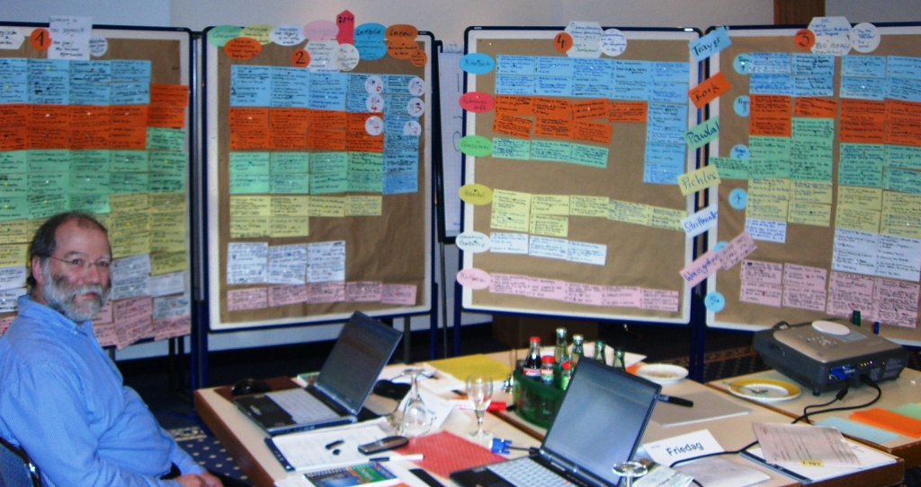
So many TAI´s
73
Notes:
73

Slide 74
For each development field of the company there have to be developed actions supporting the achievement of the goals
Example: customers
Target: awake knowledge
Action: customer visits approx. 8 weeks after
first fair-meeting
Indicator: number of visited customers
ST 1
74
Notes:
74

Slide 75
Exercise 9: Target-Action-Indicator (TAI)
What exactly do we have to do now to achieve our
strategical goals in 2015 and 2016:
Target
Action
Indicator
All three points please on one moderation-card – readable written
  You have 30 minutes time
75
Notes:
75

Slide 76
Exercise-results
9. Target-Action-Indicator (TAI)
Please use the moderations cards
strategic topic x
Target:
Action:
Indicator:
green: clients, blue: staff, white: owner, yellow: deliverers

Slide 77
Combine a strategy with the Balanced Scorecard
Agenda
01 08:00 overview what is strategy, why do you need this
02 08:30 practica exercise in 2 groups: what could be our mission / vision – with presentation
03 09:30 internal analysis and strategy choice
04 09:50 practica exercise in 2 groups:
our strategic goals (topics) for the next two years – with presentation
05 10:50 our important stakeholders
06 11:10 practical exercise in 2 groups: strategic actions
07 11:40 conclusion of the strategic process
77
Notes:
77

Slide 78
Implementation Steps for a Balanced Scorecard
I. Identification of objectives
(key image, key objective,
key indicator)
VII. Organize learning process
II. Develop strategic
action frame
Communication
VI. Arrange the BSC into the
process of leading
III. Complete action frame
with actions (collect ideas)
V. Reporting with the
Balanced Scorecard
IV. Bundle actions into
strategic projects

Slide 79
IV Implement strategic projects
we start to be a
technological market leader
worldwide innovative supplier
number of jointly developed innovations
objective
Strategic topic
Indicator
higher revenue
extension of sales dept.
sale potential
image
jointly developed innovations
# of projects
development
Recruitement of internat. oriented engineers
# of employments
Target
Project
Indicator
Customer retention
Customers
New contracts
Target
Action
Indicator
Target
Action
Indicator
Target
Action
Indicator
Target
Action
Indicator
Target
Project
Indicator
Target
Action
Indicator
Target
Project
Indicator
dedication
employees
CIP-Groups
Target
Action
Indicator
Target
Action
Indicator
Target
Action
Indicator
Target
Action
Indicator
Target
Action
Indicator
Target
Action
Indicator
Target
Project
Indicator
Target
Action
Indicator
Target
Action
Indicator
Perspectives
Perspectives
Target
Action
Indicator
Target
Action
Indicator
Target
Project
Indicator
Target
Project
Indicator
Target
Action
Indicator
Target
Action
Indicator
Target
Action
Indicator
Reliability
Partners
Audits
Target
Action
Indicator
Target
Action
Indicator
Target
Project
Indicator
Target
Action
Indicator
Target
Action
Indicator
Target
Action
Indicator
Cost consciousness
fin. & controlling
Cash Flow
Target
Action
Indicator
Target
Action
Indicator
Target
Action
Indicator
Target
Action
Indicator
Target
Action
Indicator
Target
Action
Indicator

Slide 80
House of the Balanced Scorecard – what we are doing
we start to be a
technological market leader
worldwide innovative supplier
number of jointly developed innovations
objective
Strategic topic
Indicator
higher revenue
extension of
sales dept.
sale potential
image
jointly develo-
ped innovations
# of projects
development
Recruitement of internat. oriented engineers
# of employments
Customer retention
Customers
New contracts
Target
Project
Indicator
Target
Project
Indicator
Target
Project
Indicator
dedication
employees
CIP-Groups
Perspectives
Target
Project
Indicator
Target
Project
Indicator
Reliability
Partners
Audits
Perspectives
Cost consciousness
fin. & controlling
Cash Flow

Slide 81
Implementation the strategy by BSC-projects
The most important things:
Don‘t look for perfect solutions!
Delegate responsibilities and competences, demand and support consequence!
Organise the things that can be already done.
The sooner the first success appear, the greater the acceptance of Balanced Scorecard will be.
Let us start, there‘s a lot of work ahead of us!

Slide 82

… and organize active doing
having objectives only is not enough –
we have to want to do it !
assign clear responsibilities
achieve early wins
develop adjuvant rituals
train consequent leader behaviour
pay attention: time is a critical resource
- time cannot be stored
- each process needs sufficient timing
- point in time as important as the period of time

Slide 83
The balanced scorecard puts strategy
– not control – at the center
___________________
Kaplan / Norton (1992)

Slide 84

Benefits of safeguarding the company with the help of the Balanced Scorecard
Everyone in the company knows his future
All stakeholder aim jointly in one direction
Limitation on less, on the fundamental things for the future
better operating profits as a base of sustainability
Better rating
Better results in the EFQM-Process

Slide 85
Conclusion
more successful because of strategy developemt and implementation with the help of Balanced Scorecard ?
We have joint and clearly defined operative and strategic objectives
By communication we achieve thinking, responsibility, objective-orientated action of all of our employees and partners
Better transparency creates confidence at internal and external partners
Strategy is the first task of leaders !

Slide 86
Fazit
"Balanced Scorecard is more than a performance measurement
system” Friedag / Schmidt
"Balanced scorecard is management, not measurement" Kaplan / Norton
balanced scorecard
transforms strategy into action

Slide 87
If managers have ever had a
professional modern
strategic controlling,
they will not manage without it.

Slide 88
Work on your
Future!
Strategy-development and -implementation with the
Balanced Scorecard [BSC]
Edyta Szarska Herwig Friedag
edyta.szarska@controllingpartner.pl and consult@friedag.com

