Slide 1

„Change”
ICV Work Group 2021
18.02.2021
Herwig Friedag

Slide 2
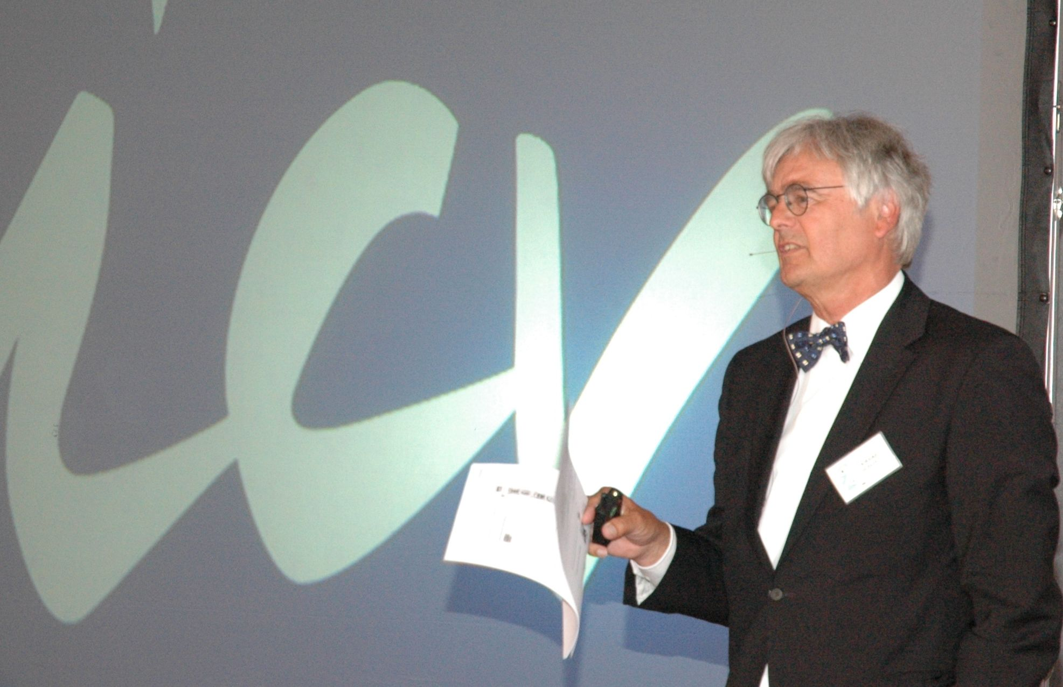

Learnings from > 20 years of consulting
Why change ?
Kinds of change
Integration of stakeholders
Participants in workshops
Workshop-procedures
Change – conclusion

Slide 3

1. Why Change
Since 1530

Slide 4
Need of change
t

Slide 5

"It is not the strongest species that survives - nor the most intelligent;
It is the one most able to adapt to change!"
___________________
Charles Darwin

Slide 6

2. Kinds of change
Only invention / innovation / renewal ?

Slide 7
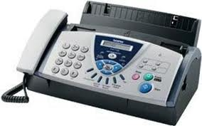
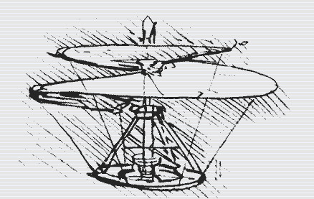
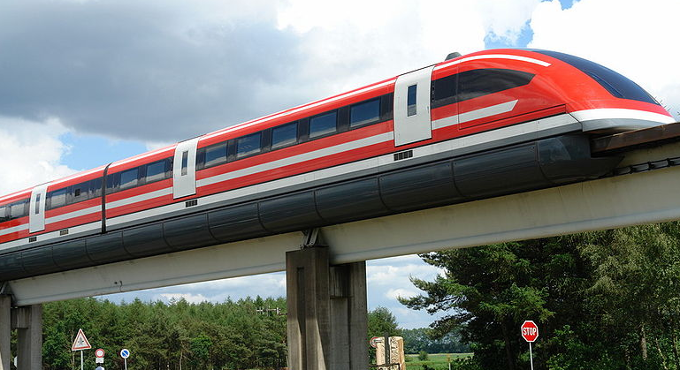
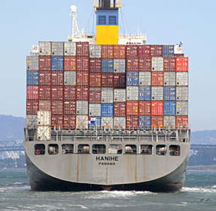
Inventions
Fax (1974)
Helicopter
Transrapid (1991)
Container (1961)
Inventions have to be brought to the market

Slide 8
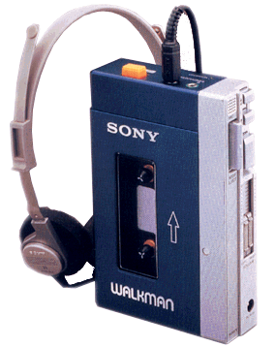
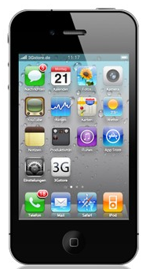
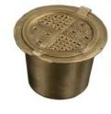

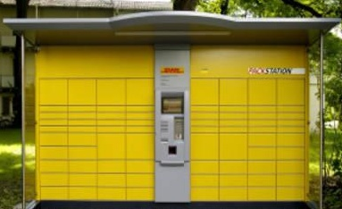
Innovations
Sony-Walkman
(1979)
iPhone
(2007)
Coffee capsule
(1986)
DHL-parcel-station (2001)
Innovations totally change the market
mRNA-Vaccine
(2020)

Slide 9
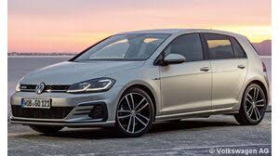
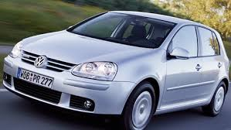
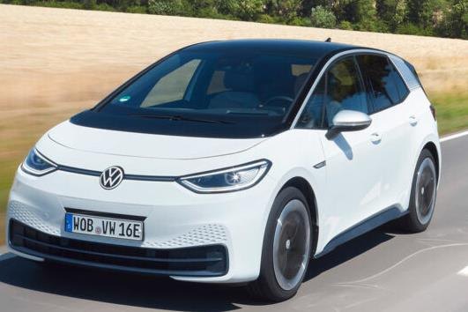
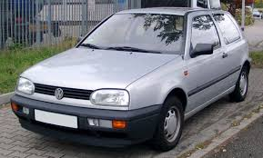
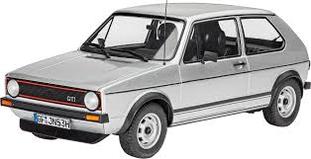
Renewals
Golf VII (2012)
Golf V (2003)
Golf III (1991)
VW ID3 (2020)
Renewals bring more value
Golf I (1974)

Slide 10
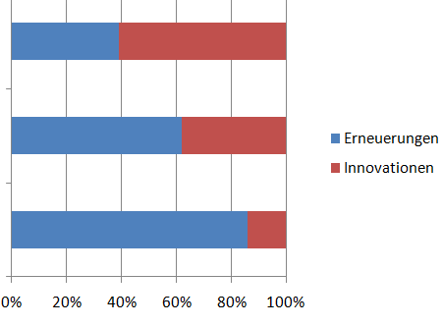
Impact of renewal / innovation
Share of profit
Turn over
Number of
inventions
Renewals
Innovations
Kim / Mauborgne: blue Ocean, page 7

Slide 11
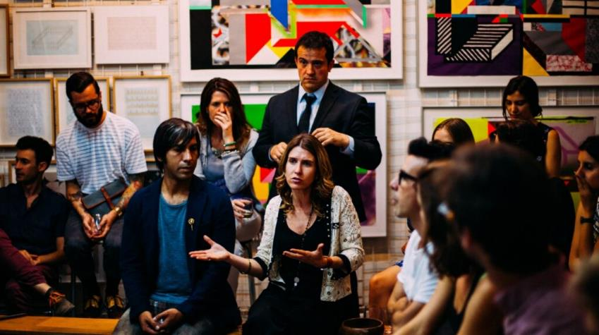
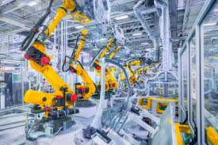


Change is more than new products
Internal culture
Production processes
Administration procedures
Sales procedures

Slide 12
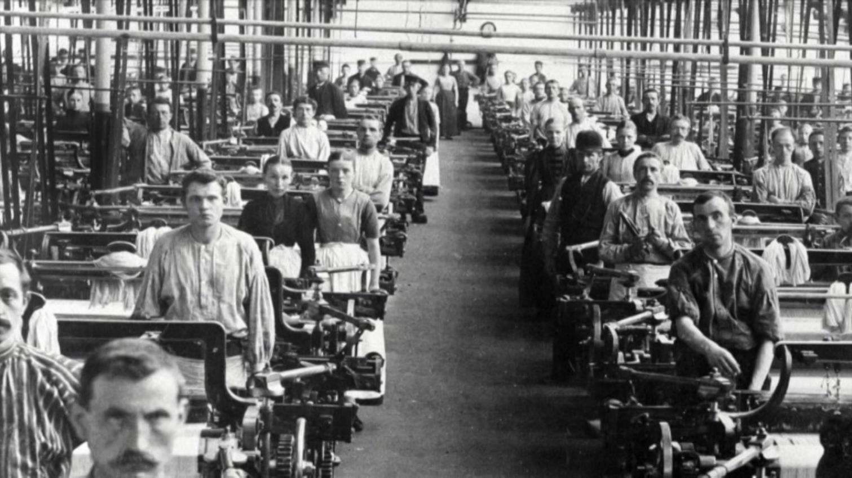
„If You always do what You always did,
You will always get what You always got."
___________________
American Wisdom

Slide 13
Q&A
How can you persuade the boss ( CEO or owner ) to start a change-process:
Highlight the change-successes of companies of the same
industry / in the region
Enable a visit in one of these companies to show the reality of a
change-process: it is not always easy !
(Succesful companies are usually proud about their results and are open for visits / exchange
with collegues)

Slide 14
Q&A
How is it possible to accomplish the engagement of second-level management for a change-process¹ ?
Demonstrate with examples the advantages of a succesful change-process:
Better reputation of the company in the market
→ better reputation of the management-members
More responsability in the company
→ more staff members mean also better reputation for the management
Rising turn-over / profits
→ better payment
Do not distribute fear among the second-level management !
¹⁾ I prefer to give positive answers

Slide 15
Survey
What do you think has been in >400 strategy-workshops
the most discussed and then executed topic-area:
Innovation
Internal culture
Production processes
Sales procedures
Administration procedures
Everybody should fix on only one topic-area

Slide 16
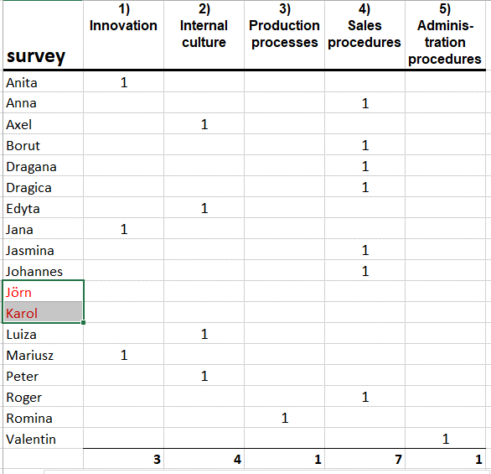
Survey result: the most discussed and then executed topic-area

Slide 17
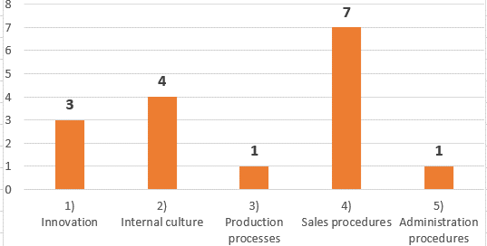
Survey result: the most discussed and then executed topic-area
It has been: internal culture !

Slide 18

3. Integration of stakeholders

Slide 19

Integrate important stakeholders
Owner / Shareholder
Staff
Clients
Deliverers
Community / Region / State

Slide 20
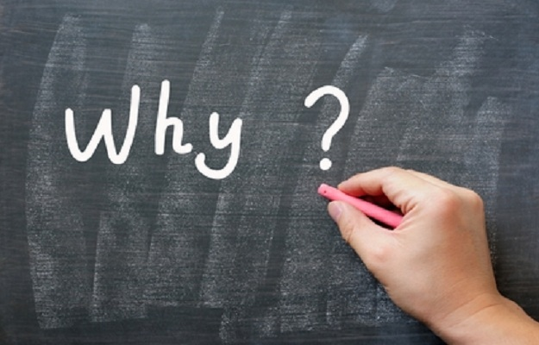
" Whoever has a why to live
bears almost every how."
___________________
Friedrich Nietzsche
We call it „mission“

Slide 21
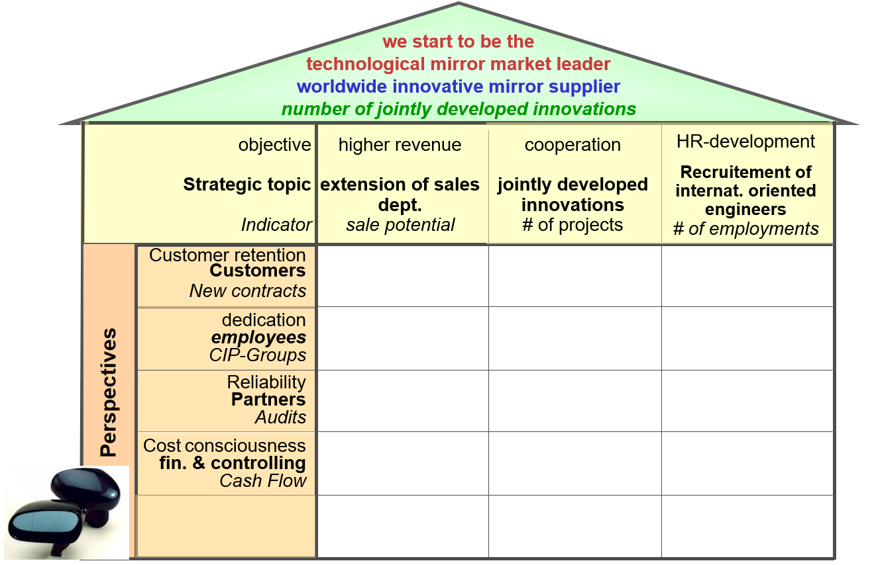
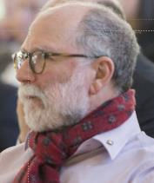
„House of the Balanced Scorecard“

Slide 22

4. Participants in workshops
Owner / Shareholder
Staff
Clients
Deliverers
Community / Region
+ CEO & Leading team
+ Controller / Assistant
+ Sales-team
+ Production-worker
+ Trainee
+ Lateral thinker
+ Union
+ ???
--------------------------------------------------------------------------------------------------------------------------------------
< than 15

Slide 23

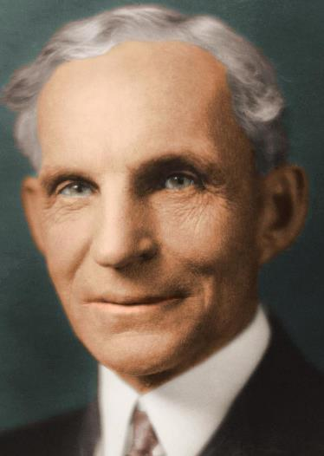
5. Workshop-procedures
„ Because thinking is the hardest work, only a few people engage in it."
___________________
Henry Ford

Slide 24
Transfer approach learnings
Reading the matter Reading 10%
Hearing the matter hearing words 20%
Look at the matter looking pictures 30%
Watching results viewing demonstrations 50%
Explain the matter give a speech 70%
Execute the matter real DOING rsp. simulation 90%
Knowing
Understanding

Slide 25
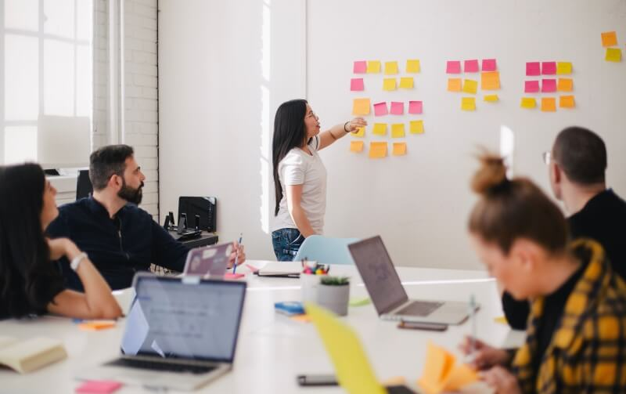
Workshop flow
+ learn to know the team before
+ short presentations (<20 min)
+ work in small teams (best 3)
People
Companies problems
Ideas for change

Slide 26
Survey
What could be reasons to prefer in workshops small teams of three
to generate, to discuss and to execute strategic activities ?
Everybody brings in proposals
Collection of many ideas / proposals
Connecting different ideas
Discussing also crazy ideas and deciding fast
Considering not only senior management ideas
Presentations improve the sense of self-worth
Disadvantage: it costs time for presenting and discussing
so many proposals
Please discuss some reasons
and write it into chatroom

Slide 27


„Creativity is just connecting things."
__________________
Steve Jobs

Slide 28
Workshop flow
+ learn to know the team before
+ short presentations (<20 min)
+ work in small teams (best 3)
+ everybody presents
+ evening with reflections
+ work-decisions in the end
+ regular check of results
------------------------------------------------------------------------------------------------------------------------------------------------------------------------
→ 10% great ideas is fine !

Slide 29
Q&A
What are best practises for a change-workshop ?
Arrange with the boss / top-management to prefer to listen instead of endless talking
(This could be a reason to engage an external consultant to conduct these cange-workshops)
Not too long discussions but quick decisions.
Nobody knows the future so every decision has the chance to fail,
or to succeed
Also for you: listen instead of knowing what is right.
The outcome should be the results of the discussions of the participants

Slide 30

Many ideas for change…
and test, test test …
to find a great result !

Slide 31
Q&A
What are best practises for the change process ?
Pay attention for quick wins; don´t wait for the end of the (at least 3 month lasting) process
All decided activities should be imlemented in less than a year
Try to decide for less than five projects parallely
(Usually we have a list of seven strategic projects after a strategy-session)
Track regularly the implementation and publish internally as well as externally the completed things; bring in a positive feeling for change
Be open for stopping a project if the results are worse than thought
(This includes the strategic figures; normally more than 50% will be exchanged after one year!)
Celebrate all finished change-activities / projects, also the failed ones

Slide 32

„The idea, the plan or the strategy alone are really not enough.
They are merely the wood.
It is enthusiasm that brings the fire to life!"
___________________
unknown

Slide 33

enthusiasm
Please pay attention to the fact that every day has only 24 hrs !

Slide 34
Q&A
How much time the top-management should invest in strategic work ?
Having five days week:
2 days for operational activities – more discussions and decidings
than doing yourself!
1 day for „fire-brigade“ operations
1 day for communication (listening !) with „normal“ staff or clients
1 day for strategic questions: discussions, decisions, tracking the
implementation
Reserve for communication as well as for strategiec topics usually a full,
always the same day – and measure it !

Slide 35
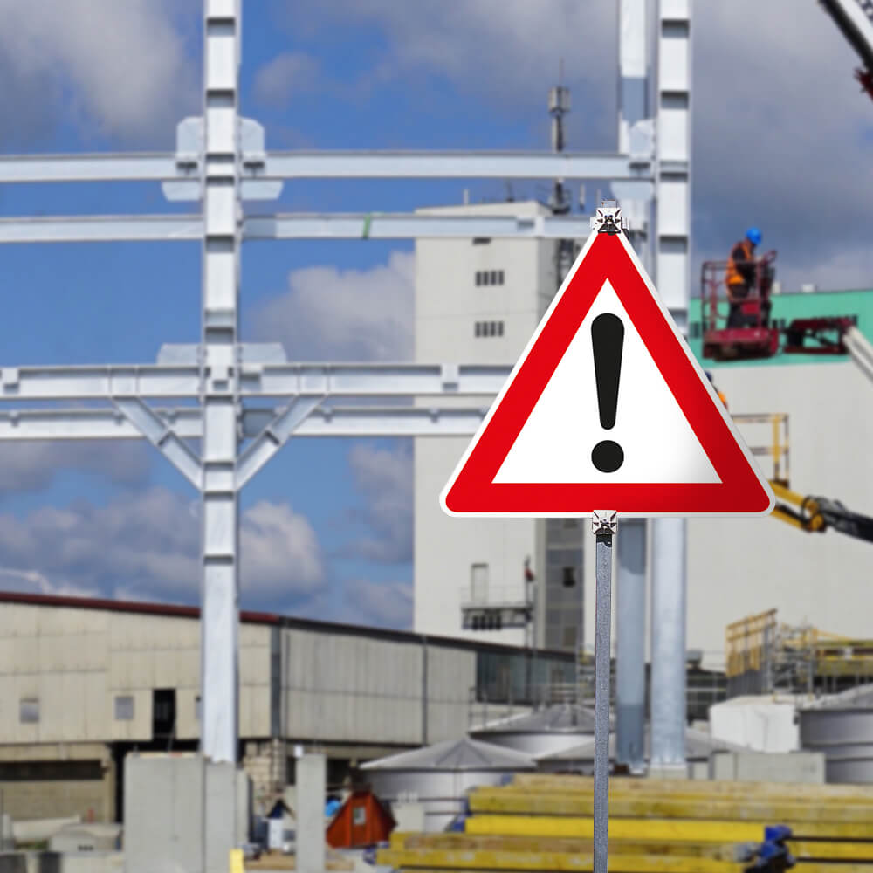
6. Change – conclusion
Perpetual change is a must in all companies / societies
Renewals are good, innovations are better,
but mostly more important is the companies culture
Workshops are good for discussions and deciding
Include the relevant stakeholder –
at least try to incorporate their interests
Assemble a mixed workshop-team
No workshop without DOING
Check the results every quarter
Don´t wait for the great idea - start now !

Slide 36
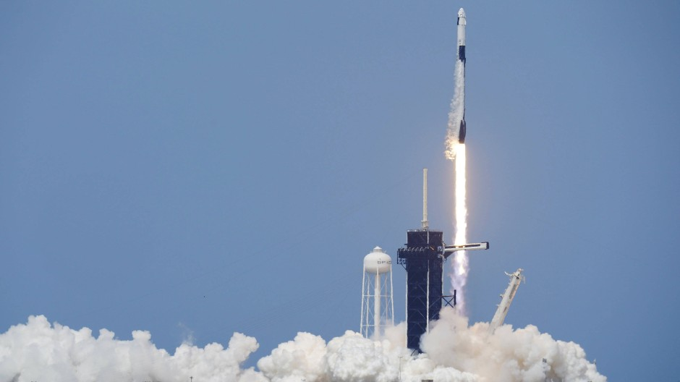
„Nothing will change
if we don't change anything."
___________________
Dr. Rabold

Slide 37

„Now: What did you miss ?
What could I add or
make better next time ?"
___________________
Herwig

