Slide 1
Team 3, Sub-Team:
„ Hydrogen” H2
Final meeting ICV Work Group 2020
07.11.2020
Sub-Team members:
Roger Maurer, Borut Kadunc

Slide 2
HYDROGEN concept

Slide 3
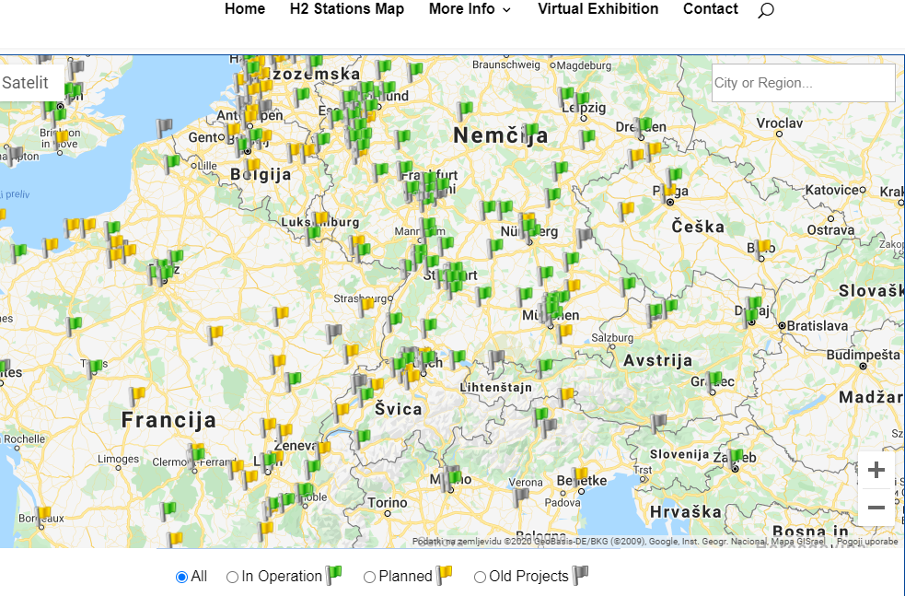
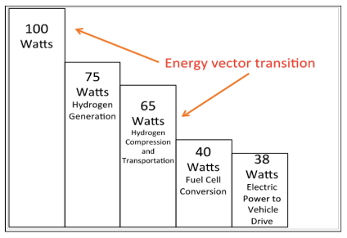
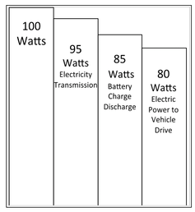
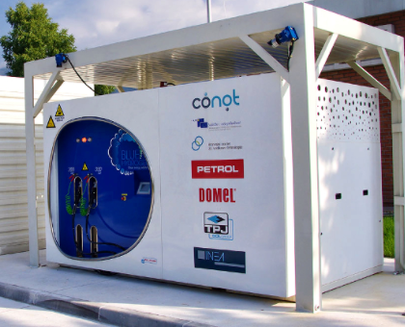
Hydrogen vs. electric car efficiency
1kg H2 = 8kg H₂O + 162 MJ electricity¸= 33,3 kW
7,5 k HV vs 5 mio EV on roads by the end of 2019
Hydrogen still has very few refuelling stations and building them is hardly going to be a priority during the coronavirus pandemic.

Slide 4
What is our dream about HYDROGEN?
Zero emission energy !
Energy independent and pollution free EU
We can not beat climate change without transportation being decarbonised.
Currently, EU imports most of energy for transportation that adds massively to pollution.
Therefore, EU is losing on energy market, however with Hydrogen it could become the winner, producing and exporting own green energy.

Slide 5
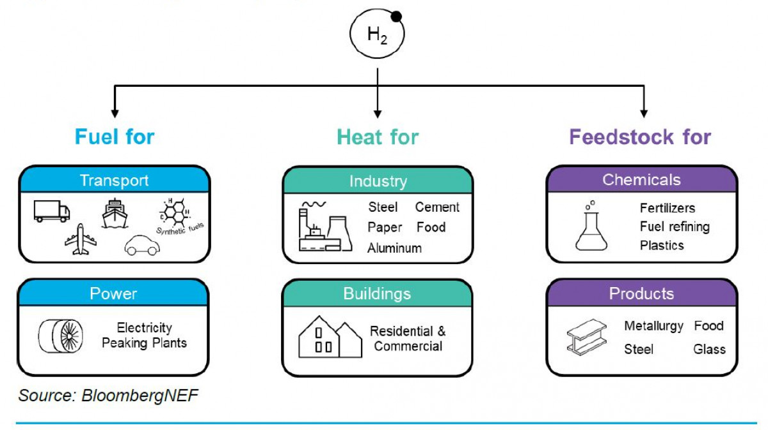
Advantages of HYDROGEN
Hydrogen is non-toxic (if produced by electrolysis with green electricity there is no emission)
Being light it can be compressed at high pressure (efficient storage)
Possibility of delivery through gas pipeline
Can be produced in large quantities and stored for a long time without loss of capacity
Help decarbonise environment Useful in many fields as shown in this picture:

Slide 6
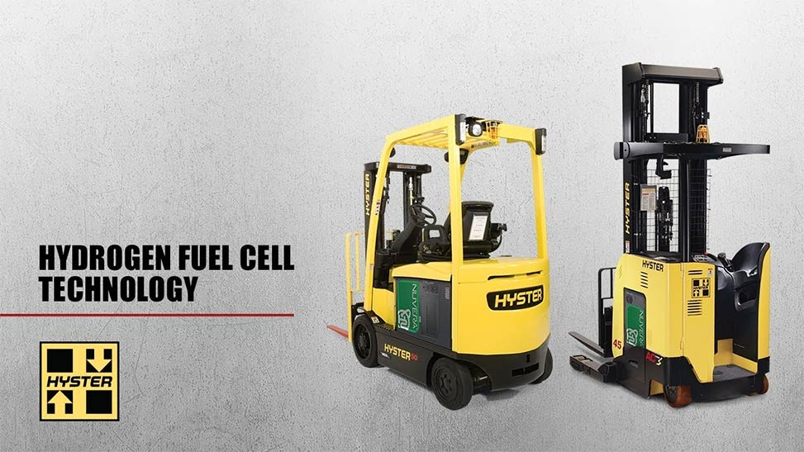
HYDROGEN used today

Slide 7
Disadvantages of HYDROGEN
Commercial planes to be on the market in 2035 & few and expensive cars exists (gas station network is thin)
Only if H2 is produced by green electricity it is ecoligical, however very expensive: producing 1 kg of hydrogen (which has a specific energy of 33,3 kWh/kg) requires 45 kWh of electricity!
Hydrogen has a high energy density by weight (three times that of gasoline or natural gas) but low by volume (even when highly compressed only 1/4 that of gasoline)
Possible market scams such as with Nikola zero emission electrical trucks.

Slide 8
HYDROGEN impact on our job as controller / CFO
The market is estimated on 140 billions by 2030. The controller has to check how H2 can impact lowering emissions in the own production facilities and estimates impacts on own products and on supplied products.
Due to present high production price for green hydrogen, own sensitivity analysis should be made on projected lower production price in the future.

Slide 9
Want to learn more on HYDROGEN
Energy Conservation in Chemotrophic Anaerobic Bacteria | file:///C:/Users/Petrol/Downloads/Thaueretal.1977.pdf
Useful Fuel Cell Equations | https://onlinelibrary.wiley.com/doi/pdf/10.1002/9781118878330.app2
Hydrogen Gas Chemical Formula | https://byjus.com/hydrogen-gas-formula/
How can I calculate the maximum yield of hydrogen | https://www.researchgate.net/post/How_can_I_calculate_the_maximum_yield_of_hydrogen_gas_from_SCWG_of_biomass
How fuel cells are used | https://www.explainthatstuff.com/fuelcells.html
Q&A EU Commission on Hydrogen | https://ec.europa.eu/commission/presscorner/detail/en/QANDA_20_1257
Hydrogen roadmap & impact | https://www.fch.europa.eu/sites/default/files/Hydrogen%20Roadmap%20Europe_Report.pdf
Hydrogen power vs gasoline | https://afdc.energy.gov/fuels/hydrogen_basics.html
Hydrogen planes | https://horizon-magazine.eu/article/quiet-and-green-why-hydrogen-planes-could-be-future-aviation.html
Hydrogen Airbus | https://www.bbc.com/news/business-54242176
Hydrogen explained | https://www.youtube.com/watch?v=uJL_D0FcZkA&feature=youtu.be
The truth about Hydrogen | https://www.youtube.com/watch?v=f7MzFfuNOtY

