Slide 1
Team 2
„Business Model” Changing the business model
in times of unexpected changes
Final meeting ICV Work Group 2020
06.11.2020
Sub-Team members:
Valentin Usenkov, Dragica Erčulj, Axel Ehberger, Dragana Mujanović , Jasmina Očko

Slide 2
Dialogue between me and my wife today:
Wife: Shall we have a dinner today?
Me: Yes, but after our ICV meeting.
Wife: Are you having ICV meeting on Friday night again?
Me: Yes.
Wife: I hate COVID…
Notes:
we choose Business Model Canvas/BMC
as a really "proper and easy to use" tool
we have heard, but never really "used" it
we want to understand the difference between BM and Canvas
we want to know more to use it properly (educate ourselves)
we want to learn more about controlling role in Business Modelling
we decided to use BMC as our basic and we built on it
questionnaire on BMC basis
we created a Questionnaire
Self education on BMC topic and later discussion
We wrote all the BMC questions and ranked them
Later we agreed to promote Questionnaire as entry ticket to out free webinar

Slide 3
What is common between COVID and ICV?
Deep analysis showed:
C O V I D
I C V
Notes:
we choose Business Model Canvas/BMC
as a really "proper and easy to use" tool
we have heard, but never really "used" it
we want to understand the difference between BM and Canvas
we want to know more to use it properly (educate ourselves)
we want to learn more about controlling role in Business Modelling
we decided to use BMC as our basic and we built on it
questionnaire on BMC basis
we created a Questionnaire
Self education on BMC topic and later discussion
We wrote all the BMC questions and ranked them
Later we agreed to promote Questionnaire as entry ticket to out free webinar

Slide 4
Agenda
Introduction
Defining and changing the Business Model: why, when, how?
Methods and tools
Something to use
Real practical case
Discussion and Conclusions

Slide 5
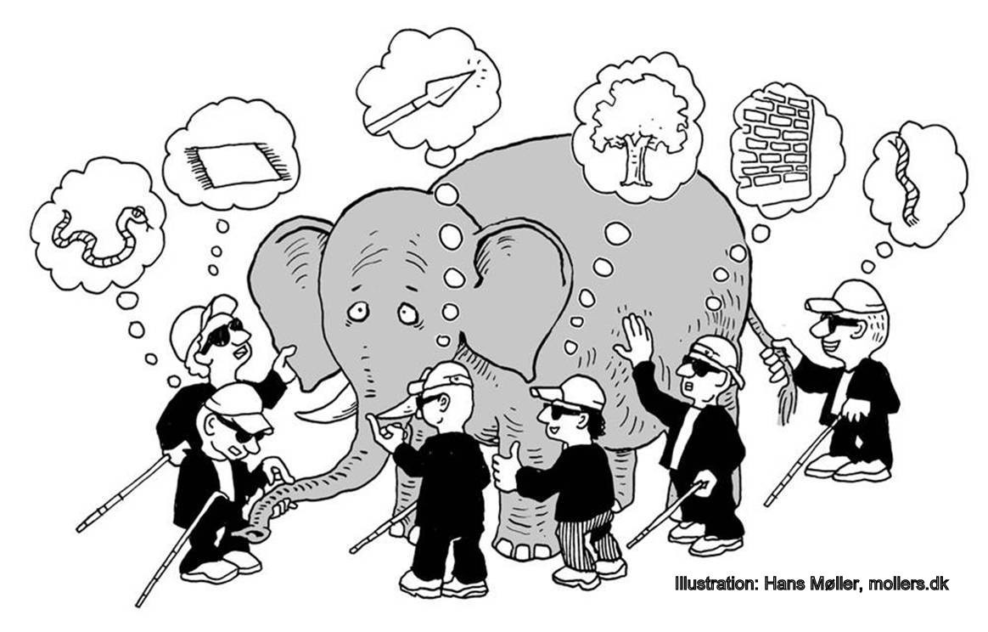
1. Introduction
Business Model

Slide 6
1. Introduction
What do we do with this promising ”Business Model” title?
Do we really understand the difference between: Business Model, Business Strategy and Business Plan?
Do we have an idea about proper use of Business Model related (controlling) tools?
Does any of us has practical experience in Business Modelling implementation?

Slide 7
1. Introduction
We educated ourselves first
We’ve chosen the tool: Business Model Canvas
We’ve created a questionary for those who want either to describe existing BM or transform it into completely new BM
We’ve organized a free webinar for those who has completed this questionary
We’ve collected a lot of feedbacks from real companies
We discovered that we made someone using it!!!
We strongly believe that Business Modelling is part of good controller’s job

Slide 8
Why?
When?
How?

Slide 9
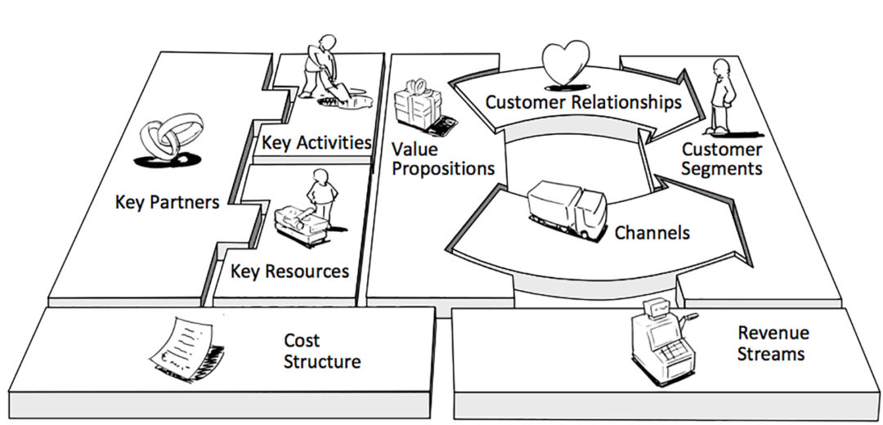
3. Methods and tools

Slide 10
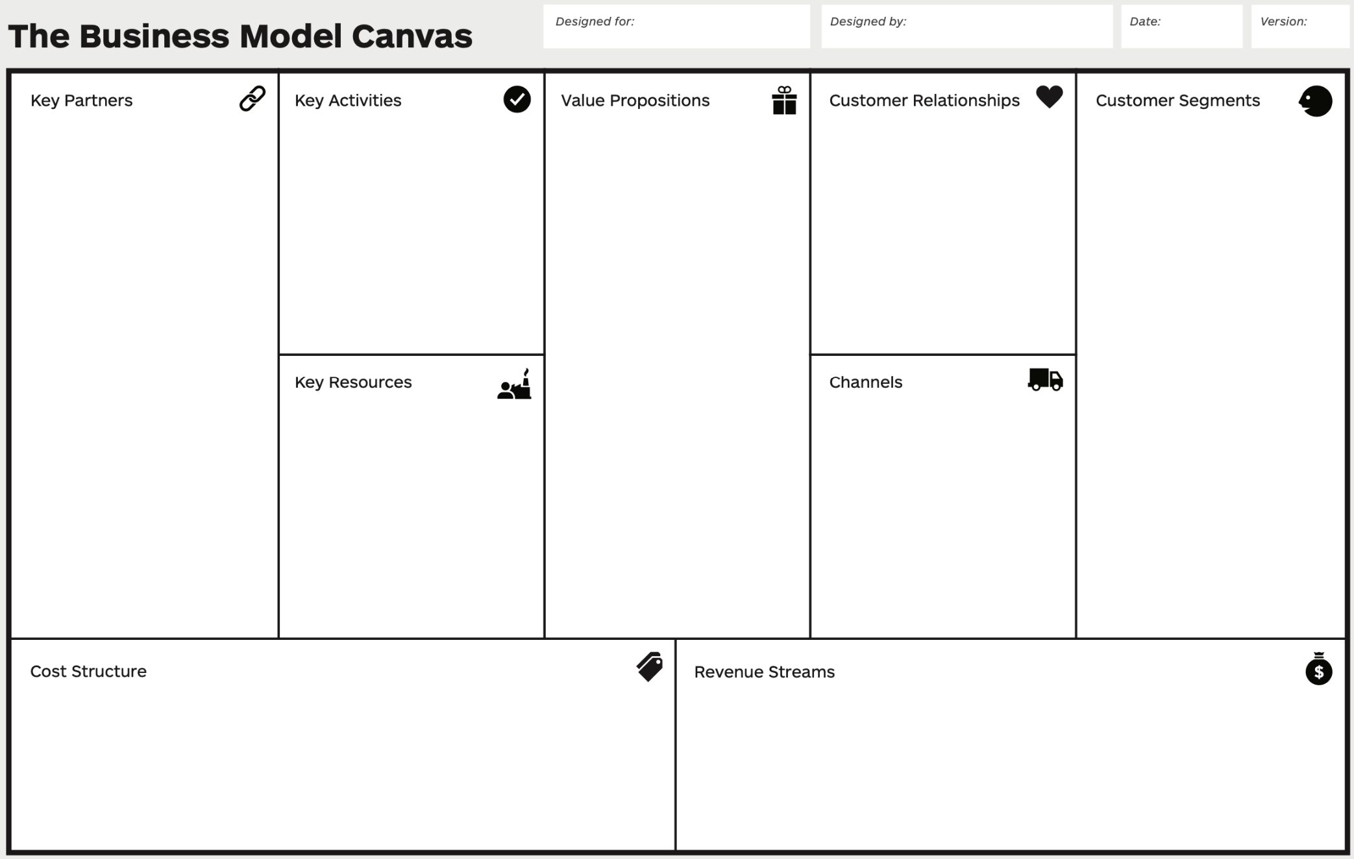
3. Methods and tools

Slide 11
3. Methods and tools

Slide 12
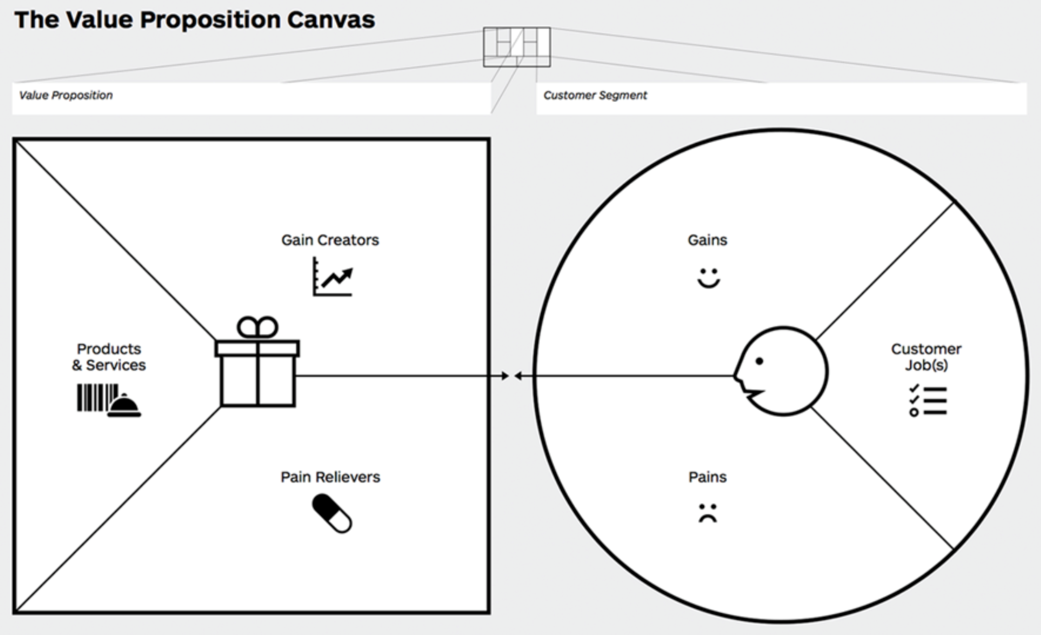
3. Methods and tools

Slide 13
3. Methods and tools
We :
Created a questionnaire with questions that can be communicated in different companies & different industries both to describe existing BM or to develop new BM
Performed an open webinar with basic explanations about BMC (answered questionnaire was used as an entry ticket)
Notes:
1. Why we decided to go with the Q?
to get an idea, how known is this model/tool, is it used in practice?
To see, how companies (in practice) are prepared for the crisis?
to identify (syncronize) existing BM
to find ideas to transform BM
to gather more experience on this topic
And, on the other hand, to promote BMC and the Controlling role
2. Our steps:
First we all have done a small research on this topic and discussed it
We prepared a small presentation to understand better and to agree on terminology (as you see it)
Prepare a questionnaire according to 9 areas of BMC
Target companies/persons: 5 countries, our clients, our participants, known companies/managers (personal approach)
Separately, each of us prepared "introduction seminar" and invitation to fill the Q
LinkedIn and Facebook promotion and invitation
Result: xy answers (from all countries)
Webinar and discussion - Russia
Interview with former target companies (Autodoc, MDM, Tusgsal)

Slide 14
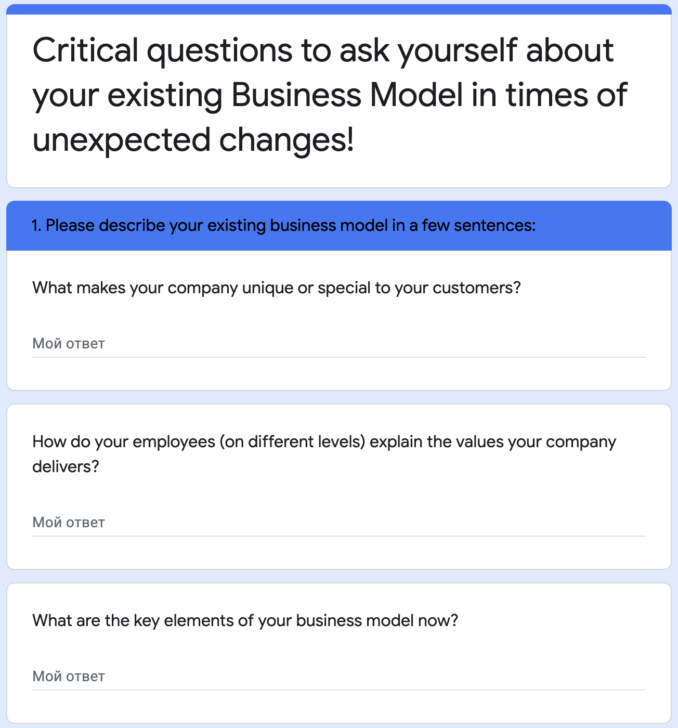
Notes:
1. Why we decided to go with the Q?
to get an idea, how known is this model/tool, is it used in practice?
To see, how companies (in practice) are prepared for the crisis?
to identify (syncronize) existing BM
to find ideas to transform BM
to gather more experience on this topic
And, on the other hand, to promote BMC and the Controlling role
2. Our steps:
First we all have done a small research on this topic and discussed it
We prepared a small presentation to understand better and to agree on terminology (as you see it)
Prepare a questionnaire according to 9 areas of BMC
Target companies/persons: 5 countries, our clients, our participants, known companies/managers (personal approach)
Separately, each of us prepared "introduction seminar" and invitation to fill the Q
LinkedIn and Facebook promotion and invitation
Result: xy answers (from all countries)
Webinar and discussion - Russia
Interview with former target companies (Autodoc, MDM, Tusgsal)

Slide 15
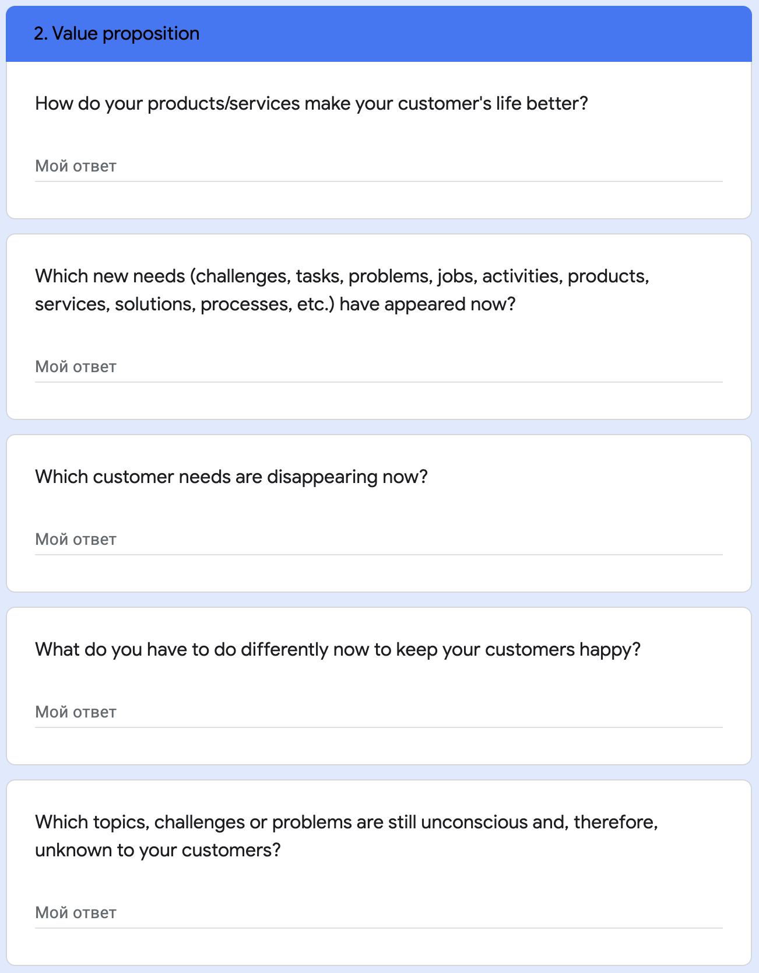
Notes:
1. Why we decided to go with the Q?
to get an idea, how known is this model/tool, is it used in practice?
To see, how companies (in practice) are prepared for the crisis?
to identify (syncronize) existing BM
to find ideas to transform BM
to gather more experience on this topic
And, on the other hand, to promote BMC and the Controlling role
2. Our steps:
First we all have done a small research on this topic and discussed it
We prepared a small presentation to understand better and to agree on terminology (as you see it)
Prepare a questionnaire according to 9 areas of BMC
Target companies/persons: 5 countries, our clients, our participants, known companies/managers (personal approach)
Separately, each of us prepared "introduction seminar" and invitation to fill the Q
LinkedIn and Facebook promotion and invitation
Result: xy answers (from all countries)
Webinar and discussion - Russia
Interview with former target companies (Autodoc, MDM, Tusgsal)

Slide 16
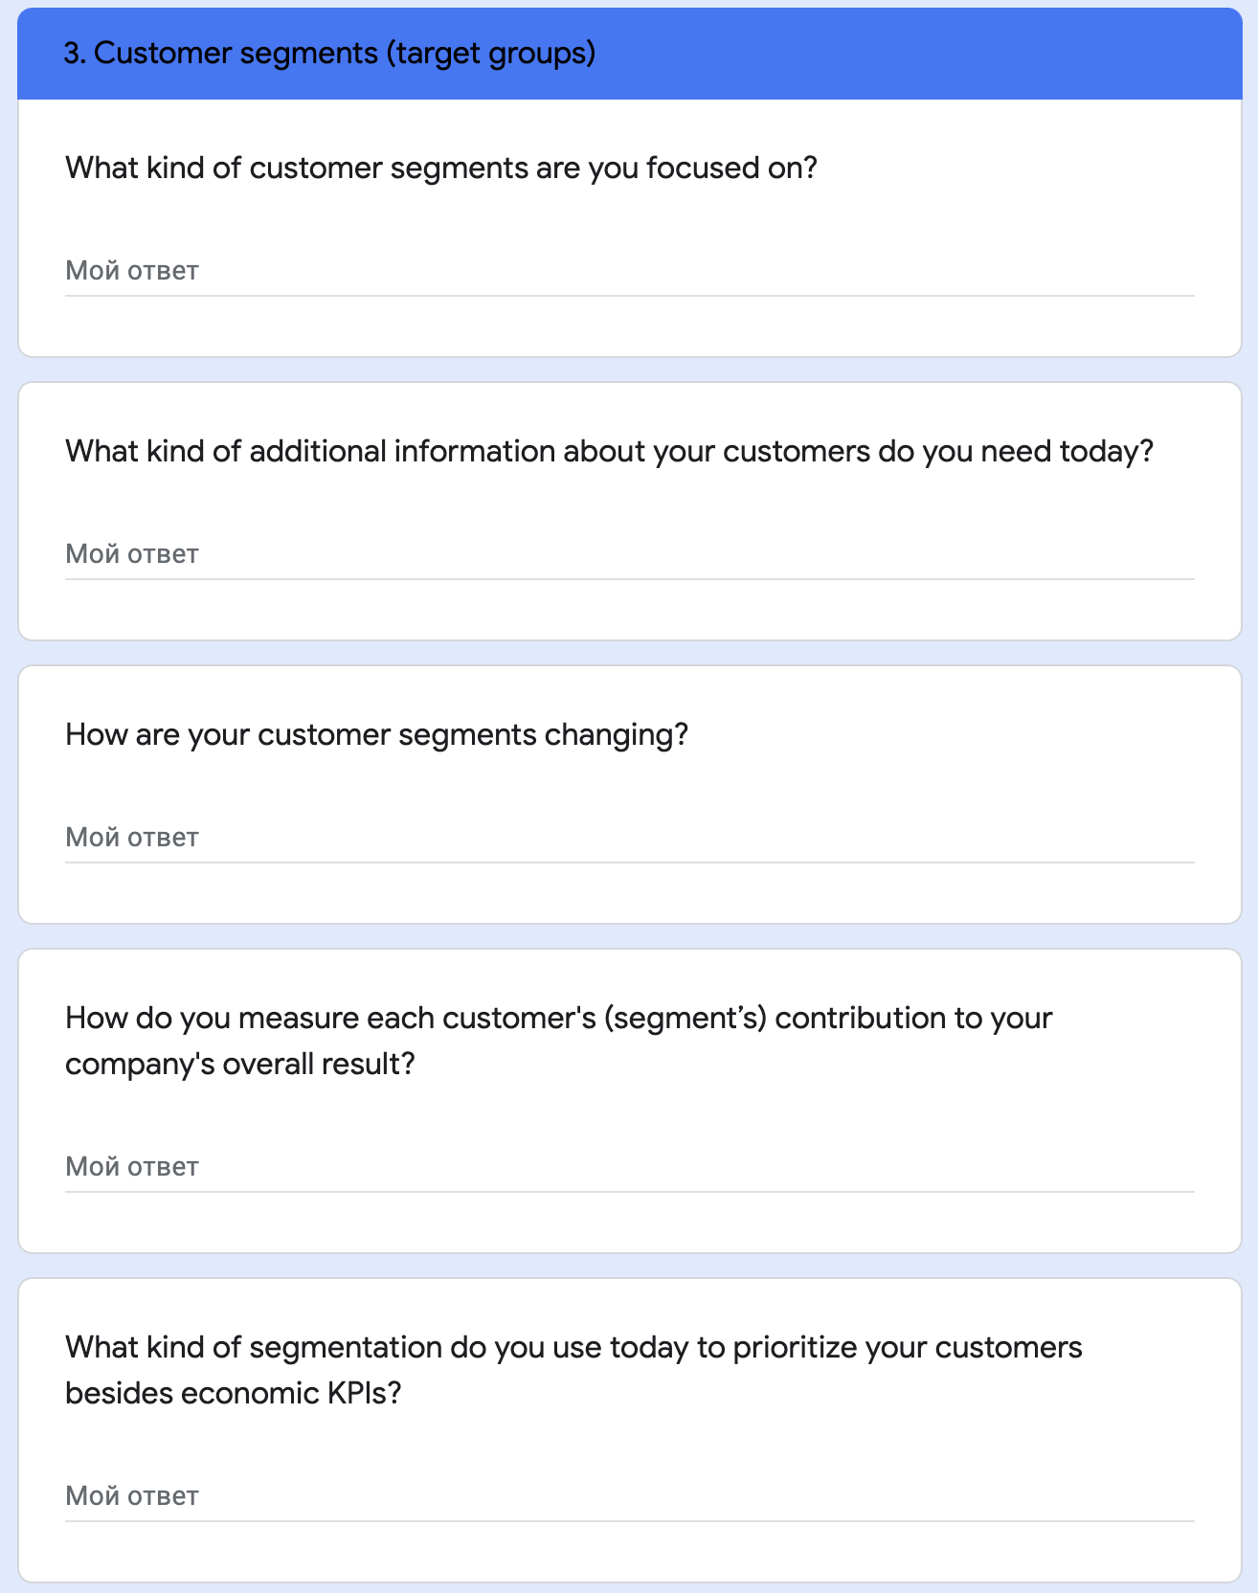
Notes:
1. Why we decided to go with the Q?
to get an idea, how known is this model/tool, is it used in practice?
To see, how companies (in practice) are prepared for the crisis?
to identify (syncronize) existing BM
to find ideas to transform BM
to gather more experience on this topic
And, on the other hand, to promote BMC and the Controlling role
2. Our steps:
First we all have done a small research on this topic and discussed it
We prepared a small presentation to understand better and to agree on terminology (as you see it)
Prepare a questionnaire according to 9 areas of BMC
Target companies/persons: 5 countries, our clients, our participants, known companies/managers (personal approach)
Separately, each of us prepared "introduction seminar" and invitation to fill the Q
LinkedIn and Facebook promotion and invitation
Result: xy answers (from all countries)
Webinar and discussion - Russia
Interview with former target companies (Autodoc, MDM, Tusgsal)

Slide 17
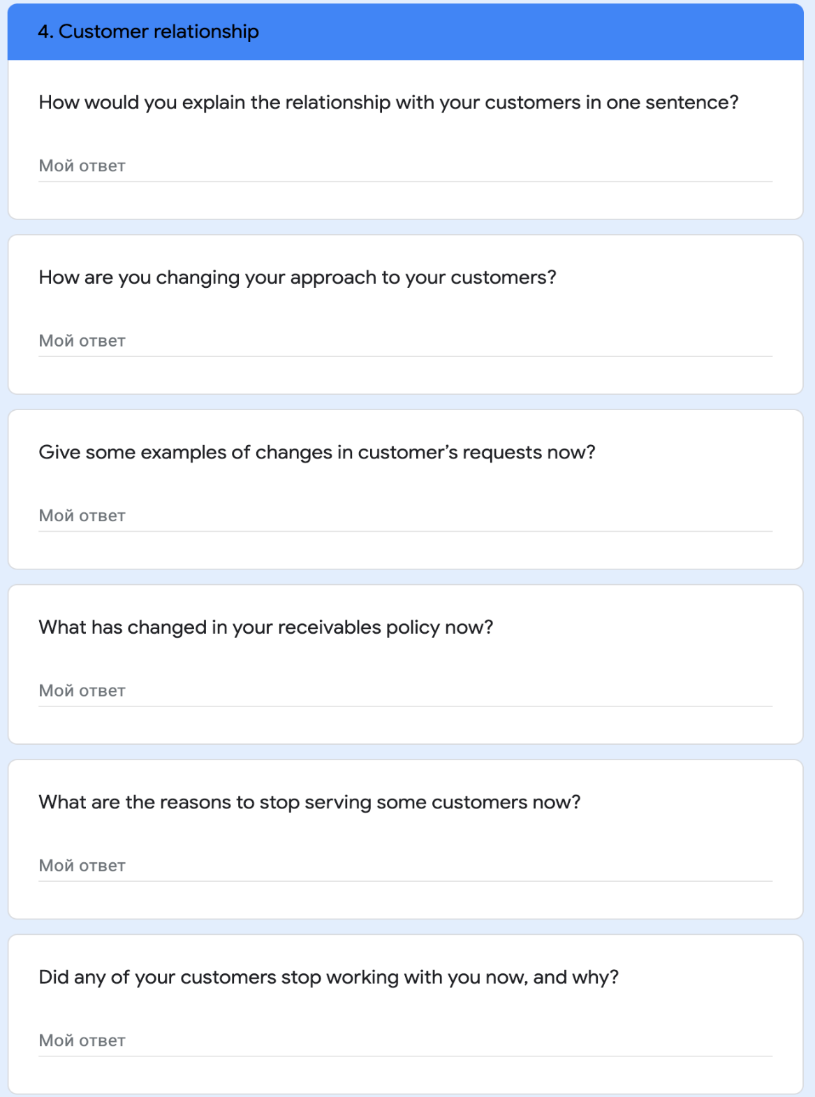
Notes:
1. Why we decided to go with the Q?
to get an idea, how known is this model/tool, is it used in practice?
To see, how companies (in practice) are prepared for the crisis?
to identify (syncronize) existing BM
to find ideas to transform BM
to gather more experience on this topic
And, on the other hand, to promote BMC and the Controlling role
2. Our steps:
First we all have done a small research on this topic and discussed it
We prepared a small presentation to understand better and to agree on terminology (as you see it)
Prepare a questionnaire according to 9 areas of BMC
Target companies/persons: 5 countries, our clients, our participants, known companies/managers (personal approach)
Separately, each of us prepared "introduction seminar" and invitation to fill the Q
LinkedIn and Facebook promotion and invitation
Result: xy answers (from all countries)
Webinar and discussion - Russia
Interview with former target companies (Autodoc, MDM, Tusgsal)

Slide 18
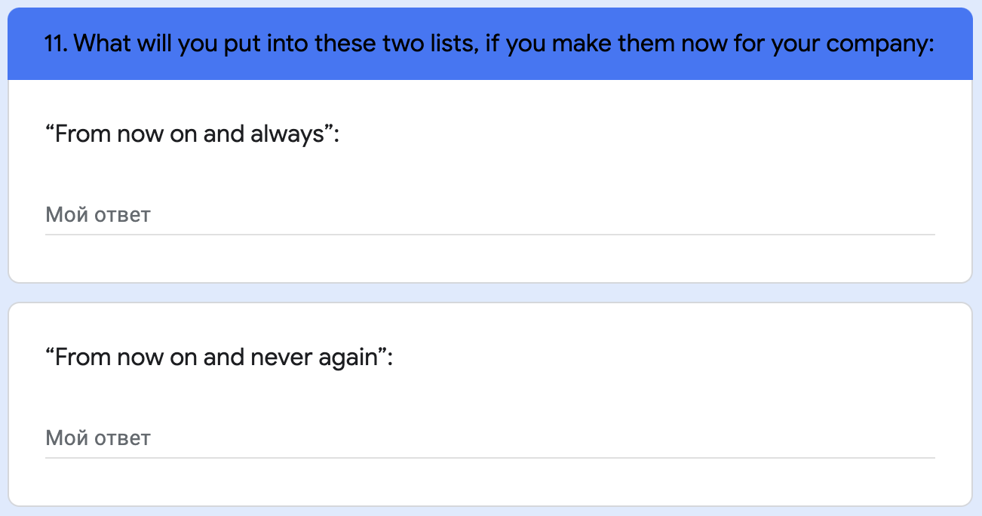
Notes:
1. Why we decided to go with the Q?
to get an idea, how known is this model/tool, is it used in practice?
To see, how companies (in practice) are prepared for the crisis?
to identify (syncronize) existing BM
to find ideas to transform BM
to gather more experience on this topic
And, on the other hand, to promote BMC and the Controlling role
2. Our steps:
First we all have done a small research on this topic and discussed it
We prepared a small presentation to understand better and to agree on terminology (as you see it)
Prepare a questionnaire according to 9 areas of BMC
Target companies/persons: 5 countries, our clients, our participants, known companies/managers (personal approach)
Separately, each of us prepared "introduction seminar" and invitation to fill the Q
LinkedIn and Facebook promotion and invitation
Result: xy answers (from all countries)
Webinar and discussion - Russia
Interview with former target companies (Autodoc, MDM, Tusgsal)

Slide 19
Notes:
1. Why we decided to go with the Q?
to get an idea, how known is this model/tool, is it used in practice?
To see, how companies (in practice) are prepared for the crisis?
to identify (syncronize) existing BM
to find ideas to transform BM
to gather more experience on this topic
And, on the other hand, to promote BMC and the Controlling role
2. Our steps:
First we all have done a small research on this topic and discussed it
We prepared a small presentation to understand better and to agree on terminology (as you see it)
Prepare a questionnaire according to 9 areas of BMC
Target companies/persons: 5 countries, our clients, our participants, known companies/managers (personal approach)
Separately, each of us prepared "introduction seminar" and invitation to fill the Q
LinkedIn and Facebook promotion and invitation
Result: xy answers (from all countries)
Webinar and discussion - Russia
Interview with former target companies (Autodoc, MDM, Tusgsal)

Slide 20
Notes:
1. Why we decided to go with the Q?
to get an idea, how known is this model/tool, is it used in practice?
To see, how companies (in practice) are prepared for the crisis?
to identify (syncronize) existing BM
to find ideas to transform BM
to gather more experience on this topic
And, on the other hand, to promote BMC and the Controlling role
2. Our steps:
First we all have done a small research on this topic and discussed it
We prepared a small presentation to understand better and to agree on terminology (as you see it)
Prepare a questionnaire according to 9 areas of BMC
Target companies/persons: 5 countries, our clients, our participants, known companies/managers (personal approach)
Separately, each of us prepared "introduction seminar" and invitation to fill the Q
LinkedIn and Facebook promotion and invitation
Result: xy answers (from all countries)
Webinar and discussion - Russia
Interview with former target companies (Autodoc, MDM, Tusgsal)

Slide 21
Notes:
1. Why we decided to go with the Q?
to get an idea, how known is this model/tool, is it used in practice?
To see, how companies (in practice) are prepared for the crisis?
to identify (syncronize) existing BM
to find ideas to transform BM
to gather more experience on this topic
And, on the other hand, to promote BMC and the Controlling role
2. Our steps:
First we all have done a small research on this topic and discussed it
We prepared a small presentation to understand better and to agree on terminology (as you see it)
Prepare a questionnaire according to 9 areas of BMC
Target companies/persons: 5 countries, our clients, our participants, known companies/managers (personal approach)
Separately, each of us prepared "introduction seminar" and invitation to fill the Q
LinkedIn and Facebook promotion and invitation
Result: xy answers (from all countries)
Webinar and discussion - Russia
Interview with former target companies (Autodoc, MDM, Tusgsal)

Slide 22
Notes:
1. Why we decided to go with the Q?
to get an idea, how known is this model/tool, is it used in practice?
To see, how companies (in practice) are prepared for the crisis?
to identify (syncronize) existing BM
to find ideas to transform BM
to gather more experience on this topic
And, on the other hand, to promote BMC and the Controlling role
2. Our steps:
First we all have done a small research on this topic and discussed it
We prepared a small presentation to understand better and to agree on terminology (as you see it)
Prepare a questionnaire according to 9 areas of BMC
Target companies/persons: 5 countries, our clients, our participants, known companies/managers (personal approach)
Separately, each of us prepared "introduction seminar" and invitation to fill the Q
LinkedIn and Facebook promotion and invitation
Result: xy answers (from all countries)
Webinar and discussion - Russia
Interview with former target companies (Autodoc, MDM, Tusgsal)

Slide 23
4. You can use it all (results and findings)
Link to questionary: https://forms.gle/hqQqKnH9RwJdhoTw9
Link to answers: https://docs.google.com/spreadsheets/d/1WkgDu2M6O9R7PH3Hd5sKDTO77FH1k0CqL3o7BpYHBm8/edit?usp=sharing
Link to Excel file with summary of all answers: https://docs.google.com/spreadsheets/d/1WkgDu2M6O9R7PH3Hd5sKDTO77FH1k0CqL3o7BpYHBm8/edit#gid=734083065
Link to webinar (english) recording: https://drive.google.com/file/d/1dLP-swyGD7k6HmSO9tK_XwcmspXc_SgT/view?usp=sharing
Notes:
What would you have done differently in 2019 if you had known about the upcoming Coronavirus COVID-19 pandemic?
Cut the salaries, accumulate more reserves, cut noneffective processes and fire nonefficient employees,
work more closely with loyal customers, get better foreign specialists, start online sales much earlier,
change intensives plan for sales managers,
buy more masks cheap, buy more materials cheap,
deversify my services, going to end user (buyer),
renegotiate office and warehouse rent contracts, do online store year ago,
transfer maximum of our processes into online
buy mask in advance, they were now just too expensive
Put digitalization into first priority
Prepare more material stock
practiced partial work from home before
More attention to online store
Release unprofitable brands
Models for cash flow and liquidity calculation
Capex on calling systems , specific Video Conference training.
Anticipation and quick reaction.

Slide 24
5. It has gone into practice quickly

Slide 25
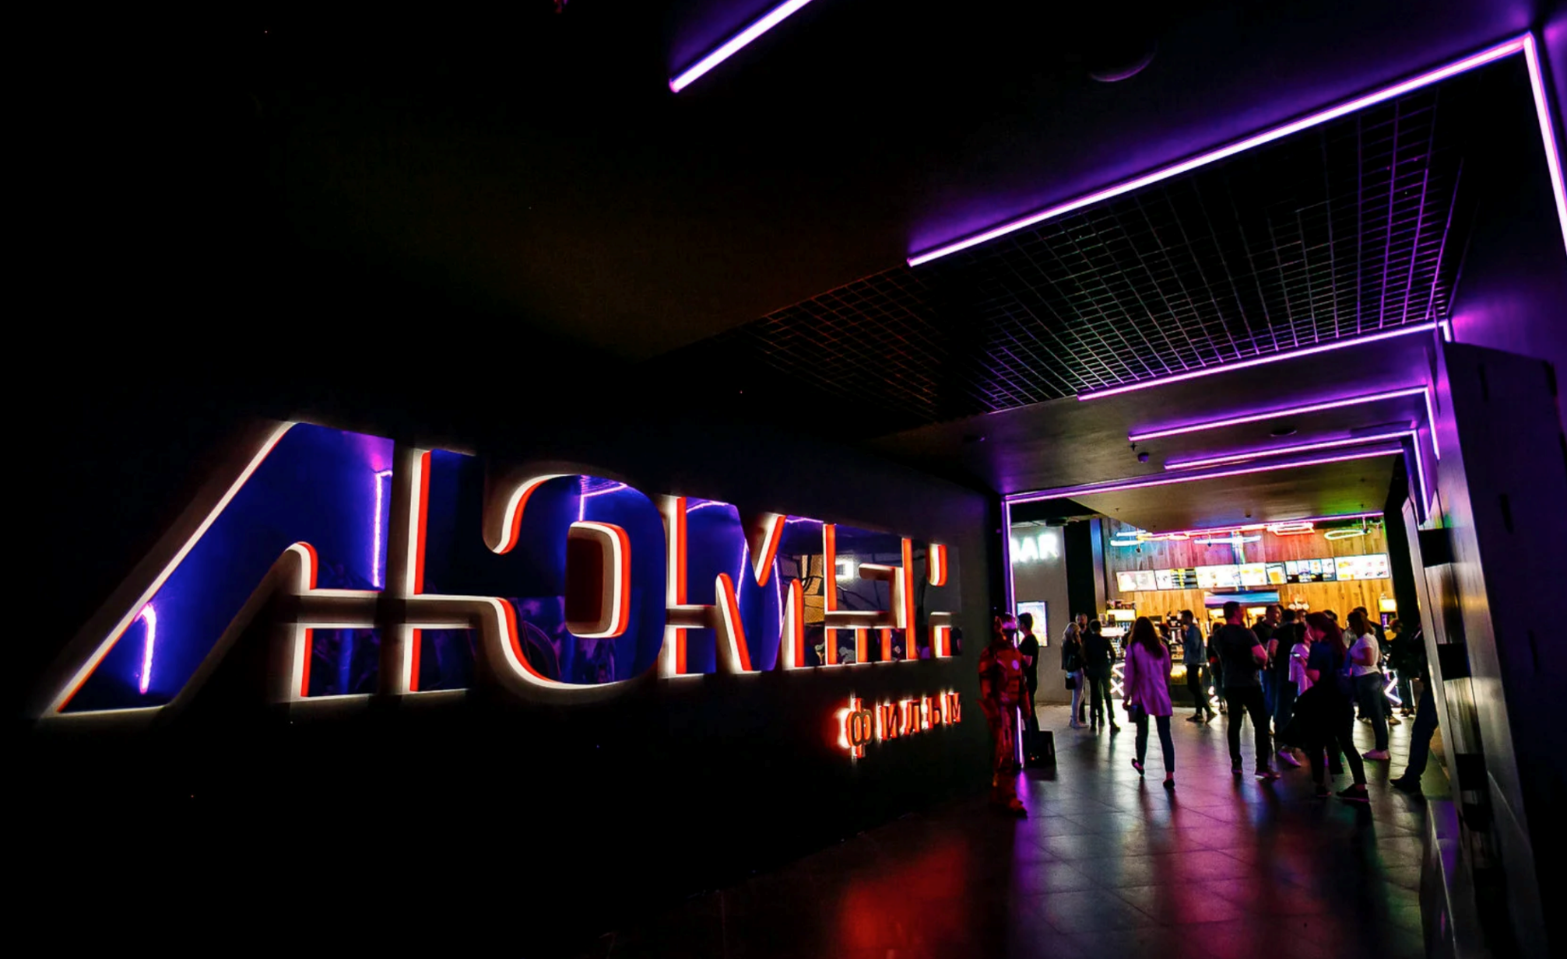

Slide 27
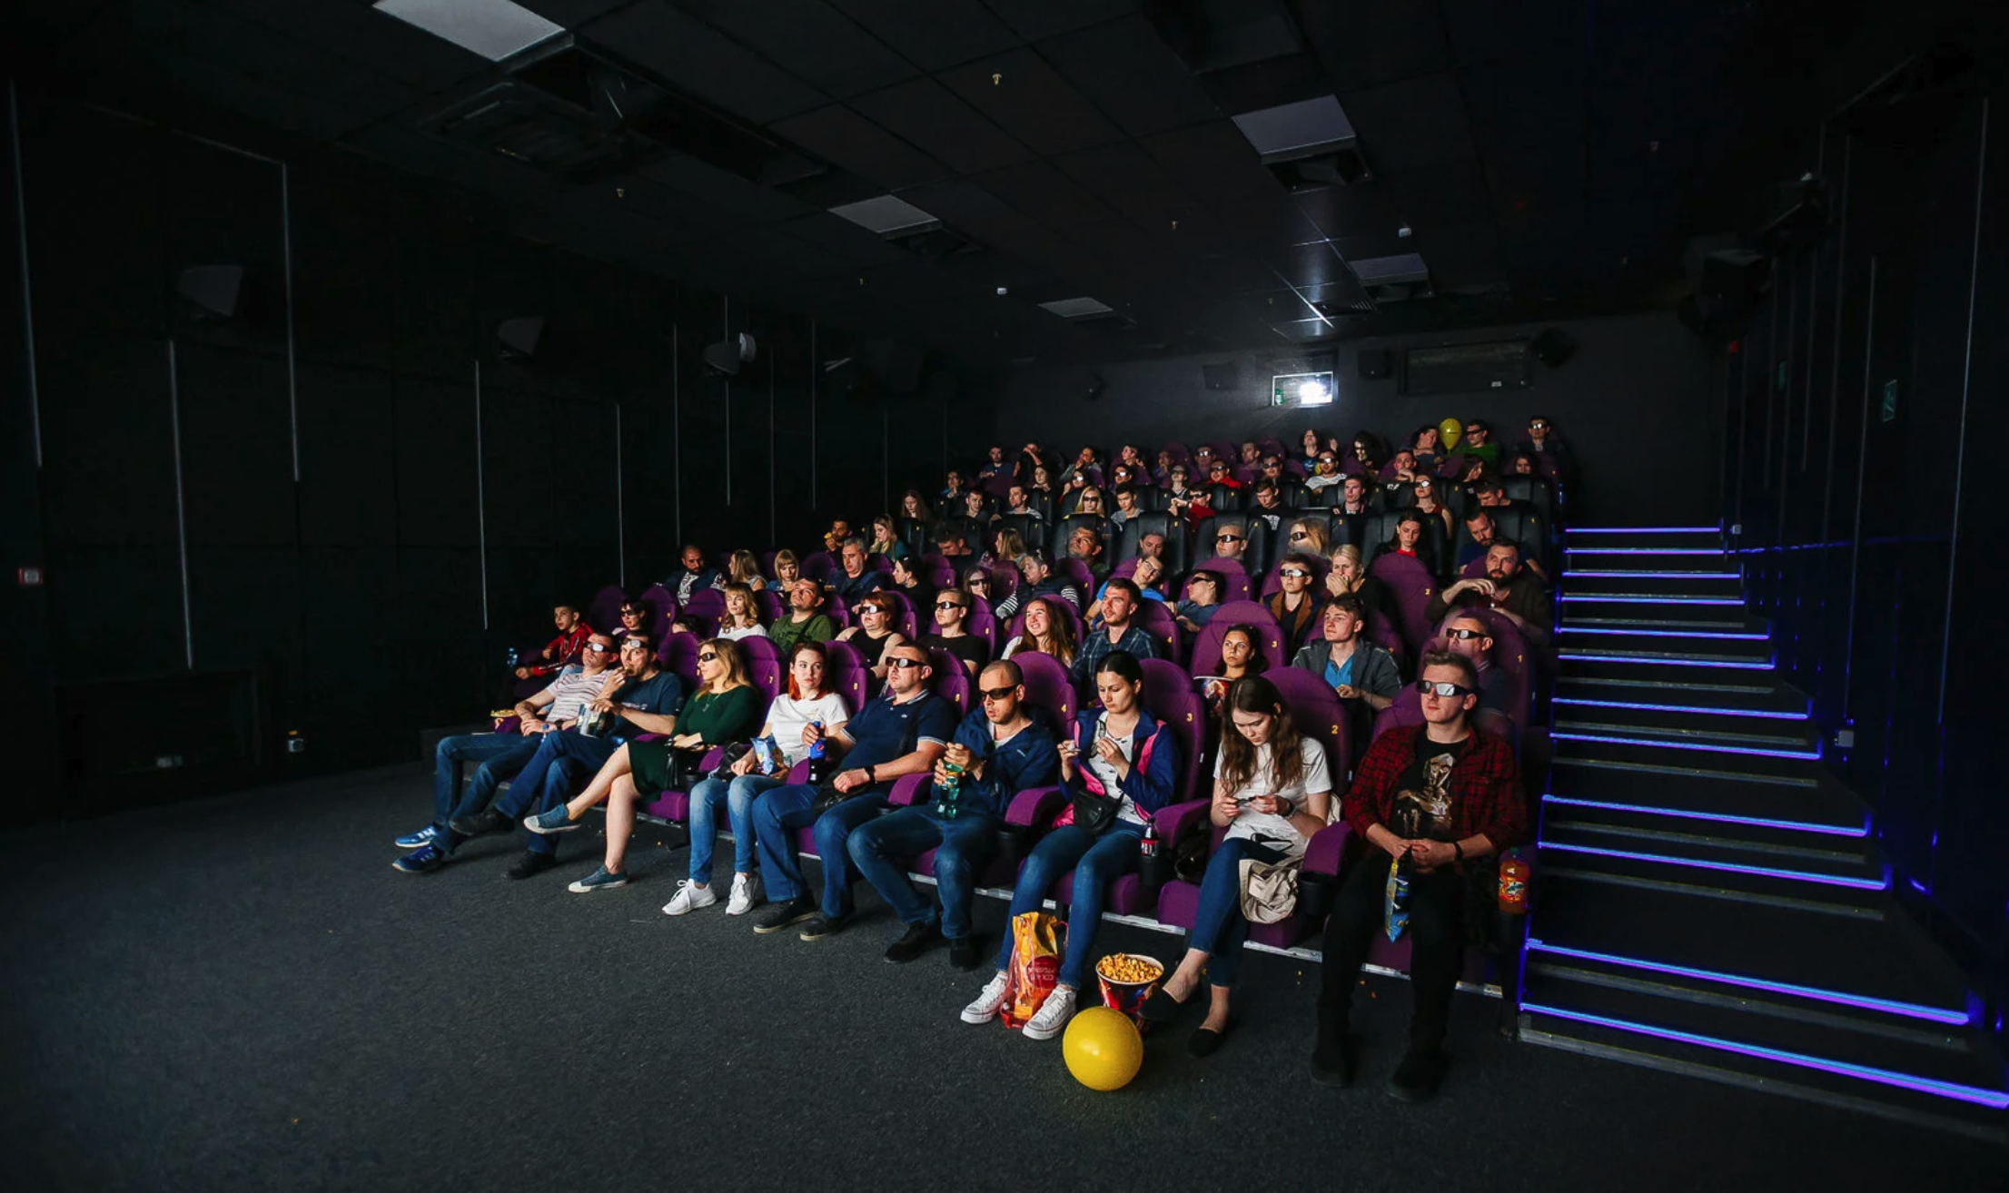

Slide 28
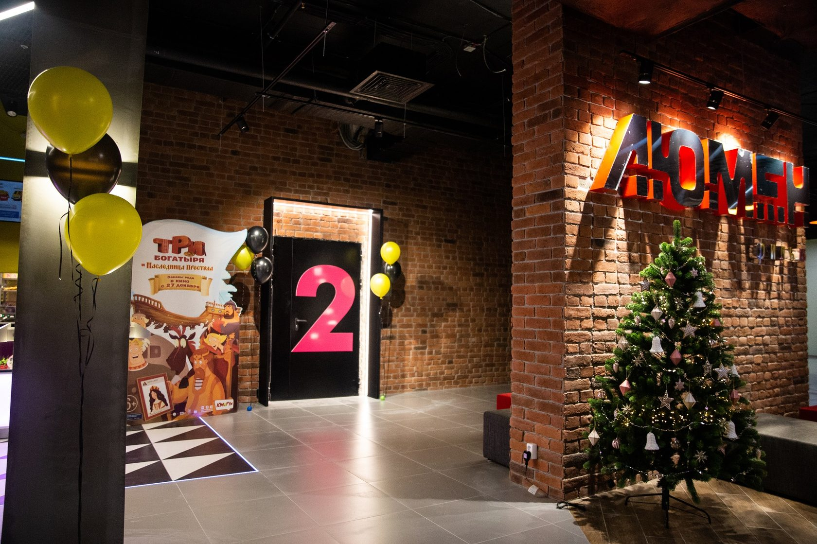

Slide 29
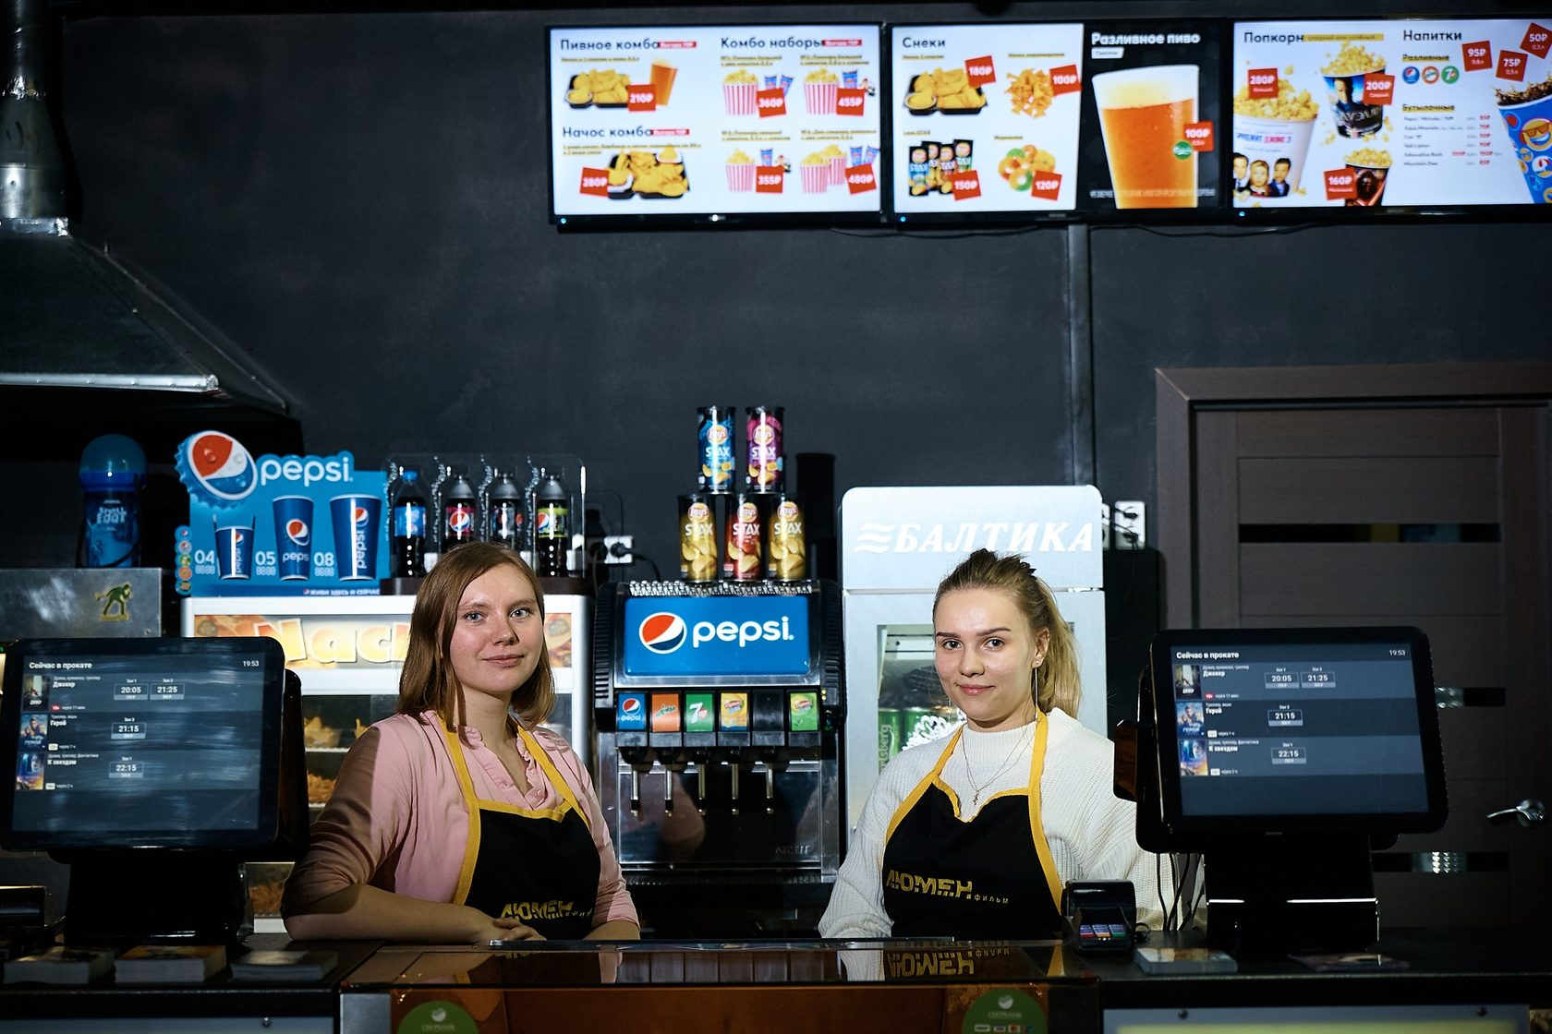

Slide 31
https://cinemaski.ru/

Slide 32
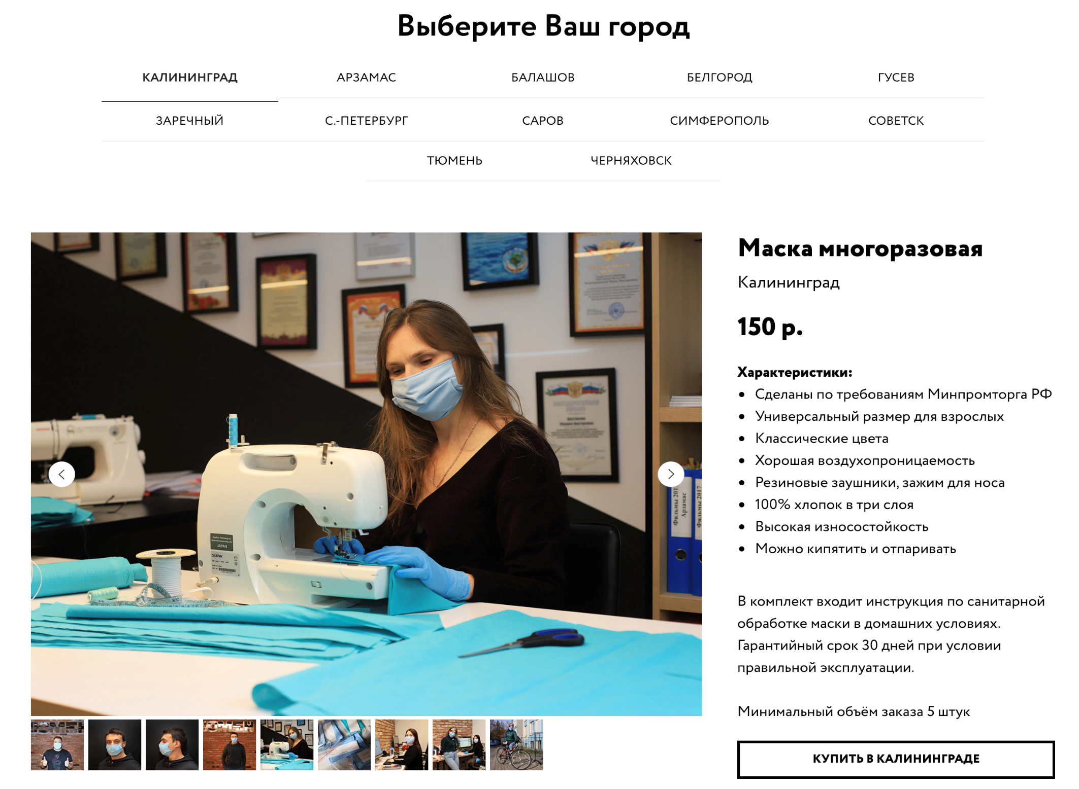

Slide 33
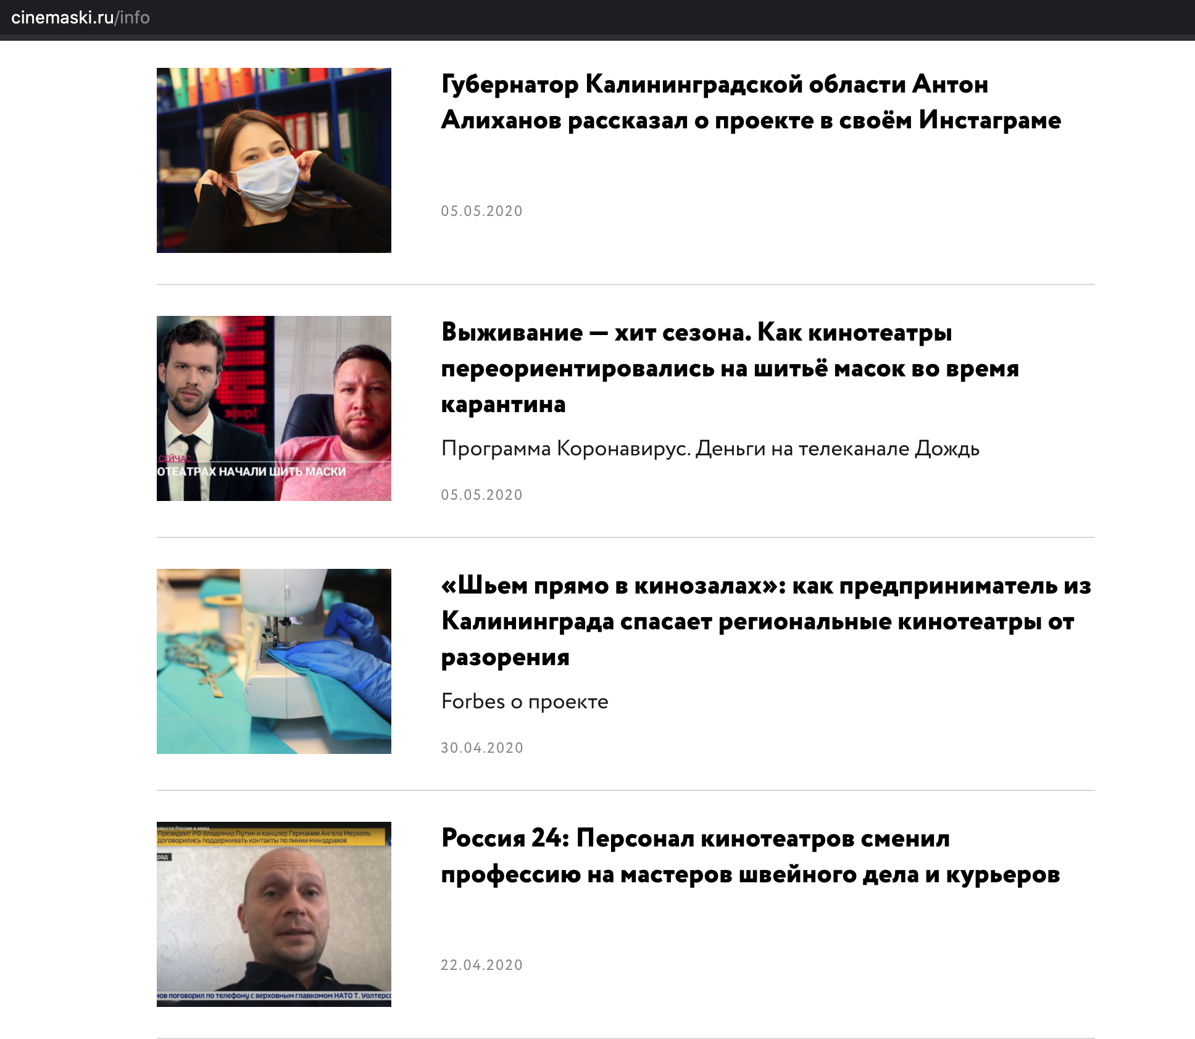

Slide 35
https://foodmarket.pro/

Slide 36
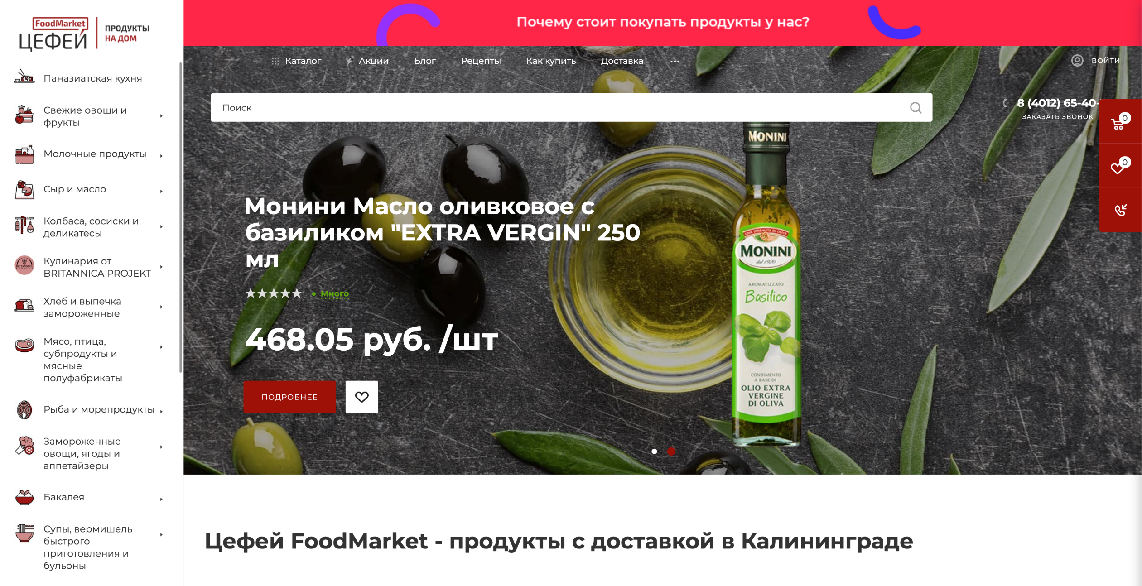
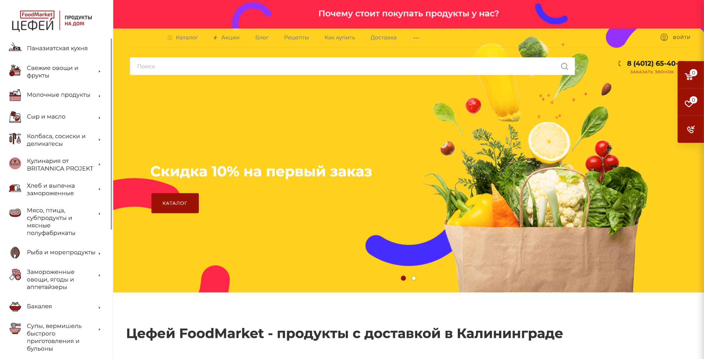

Slide 38
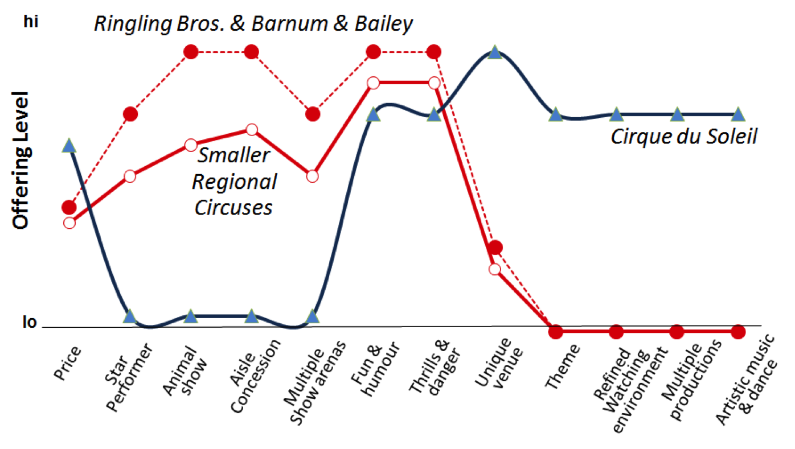

Slide 39
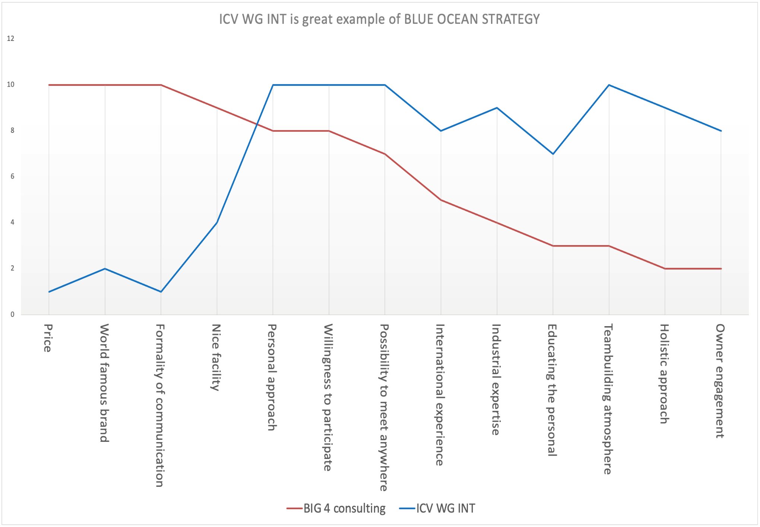

Slide 40
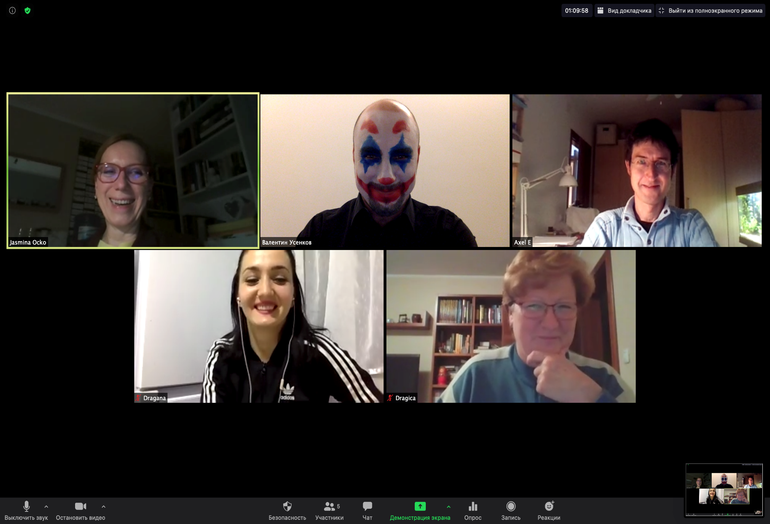
Notes:
we choose Business Model Canvas/BMC
as a really "proper and easy to use" tool
we have heard, but never really "used" it
we want to understand the difference between BM and Canvas
we want to know more to use it properly (educate ourselves)
we want to learn more about controlling role in Business Modelling
we decided to use BMC as our basic and we built on it
questionnaire on BMC basis
we created a Questionnaire
Self education on BMC topic and later discussion
We wrote all the BMC questions and ranked them
Later we agreed to promote Questionnaire as entry ticket to out free webinar

Slide 41
We strongly believe
that Business Modelling
is part of good controller’s job

